Slide 1
Module 4
Spring

Slide 2
Content to be discussed
Spring Framework
Spring AOP
Spring MVC
Spring Database
Spring REST API
Spring Boot REST

Slide 3
Spring Framework
developed by Rod Johnson in 2003. first released under the Apache 2.0 license in June 2003.
Spring framework makes the easy development of JavaEE application.
It is helpful for beginners and experienced persons.
Spring is a lightweight framework.
It can be thought of as a framework of frameworks because it provides support to various frameworks such as Struts, Hibernate, Tapestry, EJB, JSF, etc.
The framework, in broader sense, can be defined as a structure where we find solution of the various technical problems.
The Spring framework comprises several modules such as IOC, AOP, DAO, Context, ORM, WEB MVC etc.

Slide 4
Applications of Spring
POJO Based - Spring enables developers to develop enterprise-class applications using POJOs. The benefit of using only POJOs is that you do not need an EJB container product such as an application server but you have the option of using only a robust servlet container such as Tomcat or some commercial product.
Modular - Spring is organized in a modular fashion. Even though the number of packages and classes are substantial, you have to worry only about the ones you need and ignore the rest.
Integration with existing frameworks - Spring does not reinvent the wheel, instead it truly makes use of some of the existing technologies like several ORM frameworks, logging frameworks, JEE, Quartz and JDK timers, and other view technologies.
Testablity - Testing an application written with Spring is simple because environment-dependent code is moved into this framework. Furthermore, by using JavaBeanstyle POJOs, it becomes easier to use dependency injection for injecting test data.
Web MVC - Spring's web framework is a well-designed web MVC framework, which provides a great alternative to web frameworks such as Struts or other over-engineered or less popular web frameworks.
Central Exception Handling - Spring provides a convenient API to translate technology-specific exceptions (thrown by JDBC, Hibernate, or JDO, for example) into consistent, unchecked exceptions.
Lightweight - Lightweight IoC containers tend to be lightweight, especially when compared to EJB containers, for example. This is beneficial for developing and deploying applications on computers with limited memory and CPU resources.
Transaction management - Spring provides a consistent transaction management interface that can scale down to a local transaction (using a single database, for example) and scale up to global transactions (using JTA, for example).

Slide 5
Inversion Of Control (IOC) and Dependency Injection
These are the design patterns that are used to remove dependency from the programming code. They make the code easier to test and maintain. Let's understand this with the following code:
class Employee{
Address address;
Employee(){
address=new Address();
}
}

Slide 6
IOC
In such case, there is dependency between the Employee and Address (tight coupling). In the Inversion of Control scenario, we do this something like this:
class Employee{
Address address;
Employee(Address address){
this.address=address;
}
}
Thus, IOC makes the code loosely coupled. In such case, there is no need to modify the code if our logic is moved to new environment.
In Spring framework, IOC container is responsible to inject the dependency. We provide metadata to the IOC container either by XML file or annotation.
Advantage of Dependency Injection
makes the code loosely coupled so easy to maintain
makes the code easy to test

Slide 7
Advantages of Spring Framework
1) Predefined Templates - provides templates for JDBC, Hibernate, JPA etc. technologies. So there is no need to write too much code. It hides the basic steps of these technologies.
2) Loose Coupling - The Spring applications are loosely coupled because of dependency injection.
3) Easy to test - The Dependency Injection makes easier to test the application. The EJB or Struts application require server to run the application but Spring framework doesn't require server.
4) Lightweight - because of its POJO implementation. doesn't force the programmer to inherit any class or implement any interface. That is why it is said non-invasive.
5) Fast Development - The Dependency Injection feature of Spring Framework and it support to various frameworks makes the easy development of JavaEE application.
6) Powerful abstraction - provides powerful abstraction to JavaEE specifications such as JMS, JDBC, JPA and JTA.
7) Declarative support - It provides declarative support for caching, validation, transactions and formatting.

Slide 8
Spring Modules
The Spring framework comprises of many modules such as core, beans, context, expression language, AOP, Aspects, Instrumentation, JDBC, ORM, OXM, JMS, Transaction, Web, Servlet, Struts etc.
These modules are grouped into Test, Core Container, AOP, Aspects, Instrumentation, Data Access / Integration, Web (MVC / Remoting) as displayed in the following diagram.

Slide 9
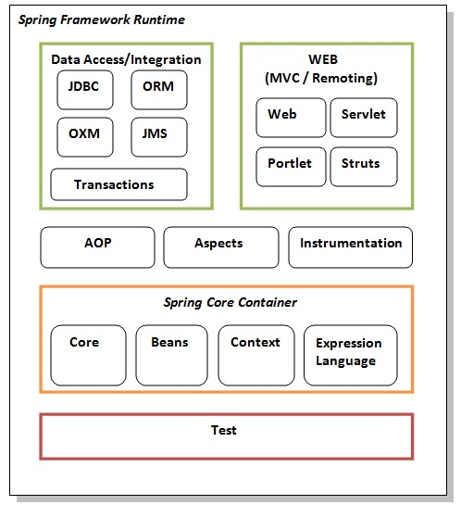
Spring Modules

Slide 10
Elements of Spring Module
Test - This layer provides support of testing with JUnit and TestNG.
Spring Core Container - contains core, beans, context and expression language (EL) modules.
Core and Beans - These modules provide IOC and Dependency Injection features.
Context - This module supports internationalization (I18N), EJB, JMS, Basic Remoting.
Expression Language - It is an extension to the EL defined in JSP. It provides support to setting and getting property values, method invocation, accessing collections and indexers, named variables, logical and arithmetic operators, retrieval of objects by name etc.
AOP, Aspects and Instrumentation - These modules support aspect oriented programming implementation where you can use Advices, Pointcuts etc. to decouple the code. The aspects module provides support to integration with AspectJ. The instrumentation module provides support to class instrumentation and classloader implementations.
Data Access / Integration - This group comprises of JDBC, ORM, OXM, JMS and Transaction modules. These modules basically provide support to interact with the database.
Web - This group comprises of Web, Web-Servlet, Web-Struts and Web-Portlet. These modules provide support to create web application.

Slide 11
Spring Example
simple steps to create the first spring application. To run this application, we are not using any IDE. We are simply using the command prompt. The simple steps to create the spring application.
create the class
create the xml file to provide the values
create the test class
Load the spring jar files
Run the test class

Slide 12
1) Create Java class
This is the simple java bean class containing the name property only.
package com.javatpoint;
public class Student {
private String name;
public String getName() {
return name;
}
public void setName(String name) {
this.name = name;
}
public void displayInfo(){
System.out.println("Hello: "+name);
}
}
This is simple bean class, containing only one property name with its getters and setters method. This class contains one extra method named displayInfo() that prints the student name by the hello message.

Slide 13
2) Create the XML file
Open the applicationContext.xml file, and write the following code:
<?xml version="1.0" encoding="UTF-8"?>
<beans
xmlns="http://www.springframework.org/schema/beans"
xmlns:xsi="http://www.w3.org/2001/XMLSchema-instance"
xmlns:p="http://www.springframework.org/schema/p"
xsi:schemaLocation="http://www.springframework.org/schema/beans
http://www.springframework.org/schema/beans/spring-beans-3.0.xsd">
<bean id="studentbean" class="com.javatpoint.Student">
<property name="name" value="Vimal Jaiswal"></property>
</bean>
</beans>
The bean element is used to define the bean for the given class. The property subelement of bean specifies the property of the Student class named name. The value specified in the property element will be set in the Student class object by the IOC container.

Slide 14
3) Create the test class
Create the java class e.g. Test. Here we are getting the object of Student class from the IOC container using the getBean() method of BeanFactory. Let's see the code of test class.
package com.javatpoint;
import org.springframework.beans.factory.BeanFactory;
import org.springframework.beans.factory.xml.XmlBeanFactory;
import org.springframework.core.io.ClassPathResource;
import org.springframework.core.io.Resource;
public class Test {
public static void main(String[] args) {
Resource resource=new ClassPathResource("applicationContext.xml");
BeanFactory factory=new XmlBeanFactory(resource);
Student student=(Student)factory.getBean("studentbean");
student.displayInfo();
}
}
The Resource object represents the information of applicationContext.xml file. The Resource is the interface and the ClassPathResource is the implementation class of the Reource interface. The BeanFactory is responsible to return the bean. The XmlBeanFactory is the implementation class of the BeanFactory. There are many methods in the BeanFactory interface. One method is getBean(), which returns the object of the associated class.

Slide 15
4) Load the jar files required for spring framework
There are mainly three jar files required to run this application.
org.springframework.core-3.0.1.RELEASE-A
com.springsource.org.apache.commons.logging-1.1.1
org.springframework.beans-3.0.1.RELEASE-A

Slide 16
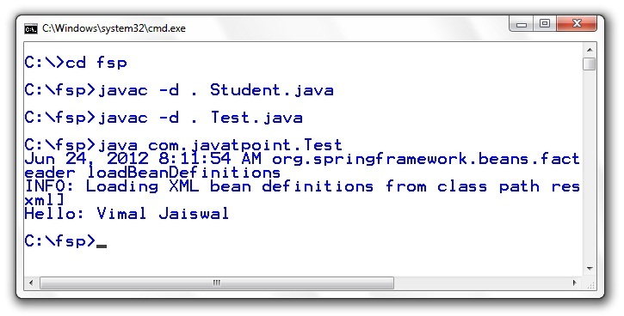
5) Run the test class

Slide 17
Creating spring application in Eclipse IDE
simple steps to create the spring application in Eclipse IDE.
create the java project
add spring jar files
create the class
create the xml file to provide the values
create the test class

Slide 18
1) Create the Java Project
Go to File menu - New - project - Java Project. Write the project name e.g. firstspring - Finish. Now the java project is created.

Slide 19
2) Add spring jar files
There are mainly three jar files required to run this application.
org.springframework.core-3.0.1.RELEASE-A
com.springsource.org.apache.commons.logging-1.1.1
org.springframework.beans-3.0.1.RELEASE-A
For the future use, You can download the required jar files for spring core application.
download the core jar files for spring
download the all jar files for spring including aop, mvc, j2ee, remoting, oxm, etc.
To run this example, you need to load only spring core jar files.
To load the jar files in eclipse IDE, Right click on your project - Build Path - Add external archives - select all the required jar files - finish..

Slide 20
3) Create Java class
In such case, we are simply creating the Student class have name property. The name of the student will be provided by the xml file. It is just a simple example not the actual use of spring. We will see the actual use in Dependency Injection chapter. To create the java class, Right click on src - New - class - Write the class name e.g. Student - finish. Write the following code:
package com.javatpoint;
public class Student {
private String name;
public String getName() {
return name;
}
public void setName(String name) {
this.name = name;
}
public void displayInfo(){
System.out.println("Hello: "+name);
}
}
This is simple bean class, containing only one property name with its getters and setters method. This class contains one extra method named displayInfo() that prints the student name by the hello message.

Slide 21
4) Create the xml file
To create the xml file click on src - new - file - give the file name such as applicationContext.xml - finish. Open the applicationContext.xml file, and write the following code:
<?xml version="1.0" encoding="UTF-8"?>
<beans
xmlns="http://www.springframework.org/schema/beans"
xmlns:xsi="http://www.w3.org/2001/XMLSchema-instance"
xmlns:p="http://www.springframework.org/schema/p"
xsi:schemaLocation="http://www.springframework.org/schema/beans
http://www.springframework.org/schema/beans/spring-beans-3.0.xsd">
<bean id="studentbean" class="com.javatpoint.Student">
<property name="name" value="Vimal Jaiswal"></property>
</bean>
</beans>
The bean element is used to define the bean for the given class. The property subelement of bean specifies the property of the Student class named name. The value specified in the property element will be set in the Student class object by the IOC container.

Slide 22
5) Create the test class
Create the java class e.g. Test. Here we are getting the object of Student class from the IOC container using the getBean() method of BeanFactory. Let's see the code of test class.
package com.javatpoint;
import org.springframework.beans.factory.BeanFactory;
import org.springframework.beans.factory.xml.XmlBeanFactory;
import org.springframework.core.io.ClassPathResource;
import org.springframework.core.io.Resource;
public class Test {
public static void main(String[] args) {
Resource resource=new ClassPathResource("applicationContext.xml");
BeanFactory factory=new XmlBeanFactory(resource);
Student student=(Student)factory.getBean("studentbean");
student.displayInfo();
}
}

Slide 23
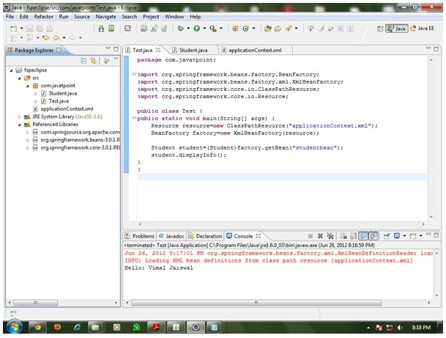
6) Run the application
Now run this class. You will get the output Hello: Vimal Jaiswal.

Slide 24
IoC Container
The IoC container is responsible to instantiate, configure and assemble the objects. The IoC container gets informations from the XML file and works accordingly.
The main tasks performed by IoC container are:
to instantiate the application class
to configure the object
to assemble the dependencies between the objects
There are two types of IoC containers. They are:
BeanFactory
ApplicationContext

Slide 25
Difference between BeanFactory and the ApplicationContext
The org.springframework.beans.factory.BeanFactory and the org.springframework.context.ApplicationContext interfaces acts as the IoC container.
The ApplicationContext interface is built on top of the BeanFactory interface. It adds some extra functionality than BeanFactory such as simple integration with Spring's AOP, message resource handling (for I18N), event propagation, application layer specific context (e.g. WebApplicationContext) for web application. So it is better to use ApplicationContext than BeanFactory.

Slide 26
Using BeanFactory
The XmlBeanFactory is the implementation class for the BeanFactory interface. To use the BeanFactory, we need to create the instance of XmlBeanFactory class as given below:
Resource resource=new ClassPathResource("applicationContext.xml");
BeanFactory factory=new XmlBeanFactory(resource);
The constructor of XmlBeanFactory class receives the Resource object so we need to pass the resource object to create the object of BeanFactory.

Slide 27
Using ApplicationContext
The ClassPathXmlApplicationContext class is the implementation class of ApplicationContext interface. We need to instantiate the ClassPathXmlApplicationContext class to use the ApplicationContext as given below:
ApplicationContext context =
new ClassPathXmlApplicationContext("applicationContext.xml");
The constructor of ClassPathXmlApplicationContext class receives string, so we can pass the name of the xml file to create the instance of ApplicationContext.

Slide 28
Spring - Bean Definition

Slide 29
Bean
The objects that form the backbone of your application and that are managed by the Spring IoC container are called beans.
A bean is an object that is instantiated, assembled, and otherwise managed by a Spring IoC container. These beans are created with the configuration metadata that you supply to the container. For example, in the form of XML <bean/> definitions
Bean definition contains the information called configuration metadata

Slide 30
Spring Configuration Metadata
three important methods to provide configuration metadata to the Spring Container
XML based configuration file.
Annotation-based configuration
Java-based configuration

Slide 31
XML-based configuration metadata
<?xml version = "1.0" encoding = "UTF-8"?>
<beans xmlns = "http://www.springframework.org/schema/beans" xmlns:xsi = "http://www.w3.org/2001/XMLSchema-instance" xsi:schemaLocation = "http://www.springframework.org/schema/beans http://www.springframework.org/schema/beans/spring-beans-3.0.xsd">
<!-- A simple bean definition --> <bean id = "..." class = "..."> <!-- collaborators and configuration for this bean go here --> </bean>
<!-- A bean definition with lazy init set on --> <bean id = "..." class = "..." lazy-init = "true"> <!-- collaborators and configuration for this bean go here --> </bean>
<!-- A bean definition with initialization method --> <bean id = "..." class = "..." init-method = "..."> <!-- collaborators and configuration for this bean go here --> </bean>
<!-- A bean definition with destruction method --> <bean id = "..." class = "..." destroy-method = "..."> <!-- collaborators and configuration for this bean go here --> </bean>
<!-- more bean definitions go here -->
</beans>

Slide 32
Dependency Injection in Spring
Dependency Injection (DI) is a design pattern that removes the dependency from the programming code so that it can be easy to manage and test the application.
Dependency Injection makes our programming code loosely coupled. To understand the DI better, Let's understand the Dependency Lookup (DL) first:

Slide 33
Dependency Lookup .
The Dependency Lookup is an approach where we get the resource after demand. There can be various ways to get the resource for example:
A obj = new AImpl();
In such way, we get the resource(instance of A class) directly by new keyword. Another way is factory method:
A obj = A.getA();
This way, we get the resource (instance of A class) by calling the static factory method getA().
Alternatively, we can get the resource by JNDI (Java Naming Directory Interface) as:
Context ctx = new InitialContext();
Context environmentCtx = (Context) ctx.lookup("java:comp/env");
A obj = (A)environmentCtx.lookup("A");
There can be various ways to get the resource to obtain the resource. Let's see the problem in this approach.

Slide 34
Problems of Dependency Lookup
tight coupling The dependency lookup approach makes the code tightly coupled. If resource is changed, we need to perform a lot of modification in the code.
Not easy for testing This approach creates a lot of problems while testing the application especially in black box testing.

Slide 35
Dependency Injection
The Dependency Injection is a design pattern that removes the dependency of the programs. In such case we provide the information from the external source such as XML file. It makes our code loosely coupled and easier for testing. In such case we write the code as:
class Employee{
Address address;
Employee(Address address){
this.address=address;
}
public void setAddress(Address address){
this.address=address;
}
}
In such case, instance of Address class is provided by external source such as XML file either by constructor or setter method.

Slide 36
Two ways to perform Dependency Injection in Spring framework
Spring framework provides two ways to inject dependency
By Constructor
By Setter method

Slide 37
Dependency Injection by Constructor Example
We can inject the dependency by constructor. The <constructor-arg> subelement of <bean> is used for constructor injection. Here we are going to inject
primitive and String-based values
Dependent object (contained object)
Collection values etc.

Slide 38
Injecting primitive and string-based values
the simple example to inject primitive and string-based values. We have created three files here:
Employee.java
applicationContext.xml
Test.java

Slide 39
Employee.java
It is a simple class containing two fields id and name. There are four constructors and one method in this class.
package com.javatpoint;
public class Employee {
private int id;
private String name;
public Employee() {System.out.println("def cons");}
public Employee(int id) {this.id = id;}
public Employee(String name) { this.name = name;}
public Employee(int id, String name) {
this.id = id;
this.name = name;
}
void show(){
System.out.println(id+" "+name);
}
}

Slide 40
applicationContext.xml
We are providing the information into the bean by this file. The constructor-arg element invokes the constructor. In such case, parameterized constructor of int type will be invoked. The value attribute of constructor-arg element will assign the specified value. The type attribute specifies that int parameter constructor will be invoked.
<?xml version="1.0" encoding="UTF-8"?>
<beans
xmlns="http://www.springframework.org/schema/beans"
xmlns:xsi="http://www.w3.org/2001/XMLSchema-instance"
xmlns:p="http://www.springframework.org/schema/p"
xsi:schemaLocation="http://www.springframework.org/schema/beans
http://www.springframework.org/schema/beans/spring-beans-3.0.xsd">
<bean id="e" class="com.javatpoint.Employee">
<constructor-arg value="10" type="int"></constructor-arg>
</bean>
</beans>

Slide 41
Test.java
This class gets the bean from the applicationContext.xml file and calls the show method.
package com.javatpoint;
import org.springframework.beans.factory.BeanFactory;
import org.springframework.beans.factory.xml.XmlBeanFactory;
import org.springframework.core.io.*;
public class Test {
public static void main(String[] args) {
Resource r=new ClassPathResource("applicationContext.xml");
BeanFactory factory=new XmlBeanFactory(r);
Employee s=(Employee)factory.getBean("e");
s.show();
}
}

Slide 42
Injecting string-based values
If you don't specify the type attribute in the constructor-arg element, by default string type constructor will be invoked.
....
<bean id="e" class="com.javatpoint.Employee">
<constructor-arg value="10"></constructor-arg>
</bean>
....
If you change the bean element as given above, string parameter constructor will be invoked and the output will be 0 10.
....
<bean id="e" class="com.javatpoint.Employee">
<constructor-arg value="Sonoo"></constructor-arg>
</bean>
....
....
<bean id="e" class="com.javatpoint.Employee">
<constructor-arg value="10" type="int" ></constructor-arg>
<constructor-arg value="Sonoo"></constructor-arg>
</bean>
....

Slide 43
Constructor Injection with Dependent Object
If there is HAS-A relationship between the classes, we create the instance of dependent object (contained object) first then pass it as an argument of the main class constructor.
Here, our scenario is Employee HAS-A Address. The Address class object will be termed as the dependent object.

Slide 44
Address.java
This class contains three properties, one constructor and toString() method to return the values of these object.
package com.javatpoint;
public class Address {
private String city;
private String state;
private String country;
public Address(String city, String state, String country) {
super();
this.city = city;
this.state = state;
this.country = country;
}
public String toString(){
return city+" "+state+" "+country;
}
}

Slide 45
Employee.java
It contains three properties id, name and address(dependent object) ,two constructors and show() method to show the records of the current object including the depedent object.
package com.javatpoint;
public class Employee {
private int id;
private String name;
private Address address;//Aggregation
public Employee() {System.out.println("def cons");}
public Employee(int id, String name, Address address) {
super();
this.id = id;
this.name = name;
this.address = address;
}
void show(){
System.out.println(id+" "+name);
System.out.println(address.toString());
}
}

Slide 46
applicationContext.xml
The ref attribute is used to define the reference of another object, such way we are passing the dependent object as an constructor argument.
<?xml version="1.0" encoding="UTF-8"?>
<beans
xmlns="http://www.springframework.org/schema/beans"
xmlns:xsi="http://www.w3.org/2001/XMLSchema-instance"
xmlns:p="http://www.springframework.org/schema/p"
xsi:schemaLocation="http://www.springframework.org/schema/beans
http://www.springframework.org/schema/beans/spring-beans-3.0.xsd">
<bean id="a1" class="com.javatpoint.Address">
<constructor-arg value="ghaziabad"></constructor-arg>
<constructor-arg value="UP"></constructor-arg>
<constructor-arg value="India"></constructor-arg>
</bean>
<bean id="e" class="com.javatpoint.Employee">
<constructor-arg value="12" type="int"></constructor-arg>
<constructor-arg value="Sonoo"></constructor-arg>
<constructor-arg>
<ref bean="a1"/>
</constructor-arg>
</bean>
</beans>

Slide 47
Test.java
This class gets the bean from the applicationContext.xml file and calls the show method. https://static.javatpoint.com/src/sp/eclipse/ci2.zip
package com.javatpoint;
import org.springframework.beans.factory.BeanFactory;
import org.springframework.beans.factory.xml.XmlBeanFactory;
import org.springframework.core.io.*;
public class Test {
public static void main(String[] args) {
Resource r=new ClassPathResource("applicationContext.xml");
BeanFactory factory=new XmlBeanFactory(r);
Employee s=(Employee)factory.getBean("e");
s.show();
}
}

Slide 48
Constructor Injection with Collection
We can inject collection values by constructor in spring framework. There can be used three elements inside the constructor-arg element.
It can be:
list
set
map
Each collection can have string based and non-string based values.

Slide 49
Example
In this example, we are taking the example of Forum where One question can have multiple answers. There are three pages:
Question.java
applicationContext.xml
Test.java
In this example, we are using list that can have duplicate elements, you may use set that have only unique elements. But, you need to change list to set in the applicationContext.xml file and List to Set in the Question.java file.

Slide 50
Question.java
This class contains three properties, two constructors and displayInfo() method that prints the information. Here, we are using List to contain the multiple answers.
package com.javatpoint;
import java.util.Iterator;
import java.util.List;
public class Question {
private int id;
private String name;
private List<String> answers;
public Question() {}
public Question(int id, String name, List<String> answers) {
super();
this.id = id;
this.name = name;
this.answers = answers;
}
public void displayInfo(){
System.out.println(id+" "+name);
System.out.println("answers are:");
Iterator<String> itr=answers.iterator();
while(itr.hasNext()){
System.out.println(itr.next());
}
}
}

Slide 51
applicationContext.xml
The list element of constructor-arg is used here to define the list.
<?xml version="1.0" encoding="UTF-8"?>
<beans
xmlns="http://www.springframework.org/schema/beans"
xmlns:xsi="http://www.w3.org/2001/XMLSchema-instance"
xmlns:p="http://www.springframework.org/schema/p"
xsi:schemaLocation="http://www.springframework.org/schema/beans
http://www.springframework.org/schema/beans/spring-beans-3.0.xsd">
<bean id="q" class="com.javatpoint.Question">
<constructor-arg value="111"></constructor-arg>
<constructor-arg value="What is java?"></constructor-arg>
<constructor-arg>
<list>
<value>Java is a programming language</value>
<value>Java is a Platform</value>
<value>Java is an Island of Indonasia</value>
</list>
</constructor-arg>
</bean>
</beans>

Slide 52
Test.java
This class gets the bean from the applicationContext.xml file and calls the displayInfo method.
package com.javatpoint;
import org.springframework.beans.factory.BeanFactory;
import org.springframework.beans.factory.xml.XmlBeanFactory;
import org.springframework.core.io.ClassPathResource;
import org.springframework.core.io.Resource;
public class Test {
public static void main(String[] args) {
Resource r=new ClassPathResource("applicationContext.xml");
BeanFactory factory=new XmlBeanFactory(r);
Question q=(Question)factory.getBean("q");
q.displayInfo();
}
}

Slide 53
Constructor Injection with Non-String Collection (having Dependent Object) Example
If we have dependent object in the collection, we can inject these information by using the ref element inside the list, set or map.
In this example, we are taking the example of Forum where One question can have multiple answers. But Answer has its own information such as answerId, answer and postedBy. There are four pages used in this example:
Question.java
Answer.java
applicationContext.xml
Test.java
In this example, we are using list that can have duplicate elements, you may use set that have only unique elements. But, you need to change list to set in the applicationContext.xml file and List to Set in the Question.java file.

Slide 54
Question.java
This class contains three properties, two constructors and displayInfo() method that prints the information. Here, we are using List to contain the multiple answers.
package com.javatpoint;
import java.util.Iterator;
import java.util.List;
public class Question {
private int id;
private String name;
private List<Answer> answers;
public Question() {}
public Question(int id, String name, List<Answer> answers) {
super();
this.id = id;
this.name = name;
this.answers = answers;
}
public void displayInfo(){
System.out.println(id+" "+name);
System.out.println("answers are:");
Iterator<Answer> itr=answers.iterator();
while(itr.hasNext()){
System.out.println(itr.next());
}
}
}

Slide 55
Answer.java
This class has three properties id, name and by with constructor and toString() method.
package com.javatpoint;
public class Answer {
private int id;
private String name;
private String by;
public Answer() {}
public Answer(int id, String name, String by) {
super();
this.id = id;
this.name = name;
this.by = by;
}
public String toString(){
return id+" "+name+" "+by;
}
}

Slide 56
applicationContext.xml
The ref element is used to define the reference of another bean. Here, we are using bean attribute of ref element to specify the reference of another bean.
<?xml version="1.0" encoding="UTF-8"?>
<beans
xmlns="http://www.springframework.org/schema/beans"
xmlns:xsi="http://www.w3.org/2001/XMLSchema-instance"
xmlns:p="http://www.springframework.org/schema/p"
xsi:schemaLocation="http://www.springframework.org/schema/beans
http://www.springframework.org/schema/beans/spring-beans-3.0.xsd">
<bean id="ans1" class="com.javatpoint.Answer">
<constructor-arg value="1"></constructor-arg>
<constructor-arg value="Java is a programming language"></constructor-arg>
<constructor-arg value="John"></constructor-arg>
</bean>
<bean id="ans2" class="com.javatpoint.Answer">
<constructor-arg value="2"></constructor-arg>
<constructor-arg value="Java is a Platform"></constructor-arg>
<constructor-arg value="Ravi"></constructor-arg>
</bean>
<bean id="q" class="com.javatpoint.Question">
<constructor-arg value="111"></constructor-arg>
<constructor-arg value="What is java?"></constructor-arg>
<constructor-arg>
<list>
<ref bean="ans1"/>
<ref bean="ans2"/>
</list>
</constructor-arg>
</bean>
</beans>

Slide 57
Test.java
This class gets the bean from the applicationContext.xml file and calls the displayInfo method.
package com.javatpoint;
import org.springframework.beans.factory.BeanFactory;
import org.springframework.beans.factory.xml.XmlBeanFactory;
import org.springframework.core.io.ClassPathResource;
import org.springframework.core.io.Resource;
public class Test {
public static void main(String[] args) {
Resource r=new ClassPathResource("applicationContext.xml");
BeanFactory factory=new XmlBeanFactory(r);
Question q=(Question)factory.getBean("q");
q.displayInfo();
}
}

Slide 58
Constructor Injection with Map Example
In this example, we are using map as the answer that have answer with posted username. Here, we are using key and value pair both as a string.
Like previous examples, it is the example of forum where one question can have multiple answers.

Slide 59
Question.java
This class contains three properties, two constructors and displayInfo() method to display the information.
package com.javatpoint;
import java.util.Iterator;
import java.util.Map;
import java.util.Set;
import java.util.Map.Entry;
public class Question {
private int id;
private String name;
private Map<String,String> answers;
public Question() {}
public Question(int id, String name, Map<String, String> answers) {
super();
this.id = id;
this.name = name;
this.answers = answers;
}
public void displayInfo(){
System.out.println("question id:"+id);
System.out.println("question name:"+name);
System.out.println("Answers....");
Set<Entry<String, String>> set=answers.entrySet();
Iterator<Entry<String, String>> itr=set.iterator();
while(itr.hasNext()){
Entry<String,String> entry=itr.next();
System.out.println("Answer:"+entry.getKey()+" Posted By:"+entry.getValue());
}
}
}

Slide 60
applicationContext.xml
The entry attribute of map is used to define the key and value information.
<?xml version="1.0" encoding="UTF-8"?>
<beans
xmlns="http://www.springframework.org/schema/beans"
xmlns:xsi="http://www.w3.org/2001/XMLSchema-instance"
xmlns:p="http://www.springframework.org/schema/p"
xsi:schemaLocation="http://www.springframework.org/schema/beans
http://www.springframework.org/schema/beans/spring-beans-3.0.xsd">
<bean id="q" class="com.javatpoint.Question">
<constructor-arg value="11"></constructor-arg>
<constructor-arg value="What is Java?"></constructor-arg>
<constructor-arg>
<map>
<entry key="Java is a Programming Language" value="Ajay Kumar"></entry>
<entry key="Java is a Platform" value="John Smith"></entry>
<entry key="Java is an Island" value="Raj Kumar"></entry>
</map>
</constructor-arg>
</bean>
</beans>

Slide 61
Test.java
This class gets the bean from the applicationContext.xml file and calls the displayInfo() method.
package com.javatpoint;
import org.springframework.beans.factory.BeanFactory;
import org.springframework.beans.factory.xml.XmlBeanFactory;
import org.springframework.core.io.ClassPathResource;
import org.springframework.core.io.Resource;
public class Test {
public static void main(String[] args) {
Resource r=new ClassPathResource("applicationContext.xml");
BeanFactory factory=new XmlBeanFactory(r);
Question q=(Question)factory.getBean("q");
q.displayInfo();
}
}

Slide 62
Constructor Injection with Non-String Map (having dependent Object) Example
In this example, we are using map as the answer that have Answer and User. Here, we are using key and value pair both as an object. Answer has its own information such as answerId, answer and postedDate, User has its own information such as userId, username, emailId.
Like previous examples, it is the example of forum where one question can have multiple answers.

Slide 63
Question.java
This class contains three properties, two constructors and displayInfo() method to display the information.
package com.javatpoint;
import java.util.Iterator;
import java.util.Map;
import java.util.Set;
import java.util.Map.Entry;
public class Question {
private int id;
private String name;
private Map<Answer,User> answers;
public Question() {}
public Question(int id, String name, Map<Answer, User> answers) {
super();
this.id = id;
this.name = name;
this.answers = answers;
}
public void displayInfo(){
System.out.println("question id:"+id);
System.out.println("question name:"+name);
System.out.println("Answers....");
Set<Entry<Answer, User>> set=answers.entrySet();
Iterator<Entry<Answer, User>> itr=set.iterator();
while(itr.hasNext()){
Entry<Answer, User> entry=itr.next();
Answer ans=entry.getKey();
User user=entry.getValue();
System.out.println("Answer Information:");
System.out.println(ans);
System.out.println("Posted By:");
System.out.println(user);
}
}
}

Slide 64
Answer.java
package com.javatpoint;
import java.util.Date;
public class Answer {
private int id;
private String answer;
private Date postedDate;
public Answer() {}
public Answer(int id, String answer, Date postedDate) {
super();
this.id = id;
this.answer = answer;
this.postedDate = postedDate;
}
public String toString(){
return "Id:"+id+" Answer:"+answer+" Posted Date:"+postedDate;
}
}

Slide 65
User.java
package com.javatpoint;
public class User {
private int id;
private String name,email;
public User() {}
public User(int id, String name, String email) {
super();
this.id = id;
this.name = name;
this.email = email;
}
public String toString(){
return "Id:"+id+" Name:"+name+" Email Id:"+email;
}
}

Slide 66
applicationContext.xml
The key-ref and value-ref attributes of entry element is used to define the reference of bean in the map.
<?xml version="1.0" encoding="UTF-8"?>
<beans
xmlns="http://www.springframework.org/schema/beans"
xmlns:xsi="http://www.w3.org/2001/XMLSchema-instance"
xmlns:p="http://www.springframework.org/schema/p"
xsi:schemaLocation="http://www.springframework.org/schema/beans
http://www.springframework.org/schema/beans/spring-beans-3.0.xsd">
<bean id="answer1" class="com.javatpoint.Answer">
<constructor-arg value="1"></constructor-arg>
<constructor-arg value="Java is a Programming Language"></constructor-arg>
<constructor-arg value="12/12/2001"></constructor-arg>
</bean>
<bean id="answer2" class="com.javatpoint.Answer">
<constructor-arg value="2"></constructor-arg>
<constructor-arg value="Java is a Platform"></constructor-arg>
<constructor-arg value="12/12/2003"></constructor-arg>
</bean>
<bean id="user1" class="com.javatpoint.User">
<constructor-arg value="1"></constructor-arg>
<constructor-arg value="Arun Kumar"></constructor-arg>
<constructor-arg value="arun@gmail.com"></constructor-arg>
</bean>
<bean id="user2" class="com.javatpoint.User">
<constructor-arg value="2"></constructor-arg>
<constructor-arg value="Varun Kumar"></constructor-arg>
<constructor-arg value="Varun@gmail.com"></constructor-arg>
</bean>
<bean id="q" class="com.javatpoint.Question">
<constructor-arg value="1"></constructor-arg>
<constructor-arg value="What is Java?"></constructor-arg>
<constructor-arg>
<map>
<entry key-ref="answer1" value-ref="user1"></entry>
<entry key-ref="answer2" value-ref="user2"></entry>
</map>
</constructor-arg>
</bean>
</beans>

Slide 67
Test.java
This class gets the bean from the applicationContext.xml file and calls the displayInfo() method to display the information.
package com.javatpoint;
import org.springframework.beans.factory.BeanFactory;
import org.springframework.beans.factory.xml.XmlBeanFactory;
import org.springframework.core.io.ClassPathResource;
import org.springframework.core.io.Resource;
public class Test {
public static void main(String[] args) {
Resource r=new ClassPathResource("applicationContext.xml");
BeanFactory factory=new XmlBeanFactory(r);
Question q=(Question)factory.getBean("q");
q.displayInfo();
}
}

Slide 68
Inheriting Bean in Spring
By using the parent attribute of bean, we can specify the inheritance relation between the beans. In such case, parent bean values will be inherited to the current bean.
Let's see the simple example to inherit the bean.

Slide 69
Employee.java
This class contains three properties, three constructor and show() method to display the values.
package com.javatpoint;
public class Employee {
private int id;
private String name;
private Address address;
public Employee() {}
public Employee(int id, String name) {
super();
this.id = id;
this.name = name;
}
public Employee(int id, String name, Address address) {
super();
this.id = id;
this.name = name;
this.address = address;
}
void show(){
System.out.println(id+" "+name);
System.out.println(address);
}
}

Slide 70
Address.java
package com.javatpoint;
public class Address {
private String addressLine1,city,state,country;
public Address(String addressLine1, String city, String state, String country) {
super();
this.addressLine1 = addressLine1;
this.city = city;
this.state = state;
this.country = country;
}
public String toString(){
return addressLine1+" "+city+" "+state+" "+country;
}
}

Slide 71
applicationContext.xml
<?xml version="1.0" encoding="UTF-8"?>
<beans
xmlns="http://www.springframework.org/schema/beans"
xmlns:xsi="http://www.w3.org/2001/XMLSchema-instance"
xmlns:p="http://www.springframework.org/schema/p"
xsi:schemaLocation="http://www.springframework.org/schema/beans
http://www.springframework.org/schema/beans/spring-beans-3.0.xsd">
<bean id="e1" class="com.javatpoint.Employee">
<constructor-arg value="101"></constructor-arg>
<constructor-arg value="Sachin"></constructor-arg>
</bean>
<bean id="address1" class="com.javatpoint.Address">
<constructor-arg value="21,Lohianagar"></constructor-arg>
<constructor-arg value="Ghaziabad"></constructor-arg>
<constructor-arg value="UP"></constructor-arg>
<constructor-arg value="USA"></constructor-arg>
</bean>
<bean id="e2" class="com.javatpoint.Employee" parent="e1">
<constructor-arg ref="address1"></constructor-arg>
</bean>
</beans>

Slide 72
Test.java
This class gets the bean from the applicationContext.xml file and calls the show method.
package com.javatpoint;
import org.springframework.beans.factory.BeanFactory;
import org.springframework.beans.factory.xml.XmlBeanFactory;
import org.springframework.core.io.ClassPathResource;
import org.springframework.core.io.Resource;
public class Test {
public static void main(String[] args) {
Resource r=new ClassPathResource("applicationContext.xml");
BeanFactory factory=new XmlBeanFactory(r);
Employee e1=(Employee)factory.getBean("e2");
e1.show();
}
}

Slide 73
Dependency Injection by setter method
We can inject the dependency by setter method also. The <property> subelement of <bean> is used for setter injection. Here we are going to inject
primitive and String-based values
Dependent object (contained object)
Collection values etc.

Slide 74
Injecting primitive and string-based values by setter method
Let's see the simple example to inject primitive and string-based values by setter method. We have created three files here:
Employee.java
applicationContext.xml
Test.java

Slide 75
Employee.java
It is a simple class containing three fields id, name and city with its setters and getters and a method to display these informations.
package com.javatpoint;
public class Employee {
private int id;
private String name;
private String city;
public int getId() {
return id;
}
public void setId(int id) {
this.id = id;
}
public String getName() {
return name;
}
public void setName(String name) {
this.name = name;
}
public String getCity() {
return city;
}
public void setCity(String city) {
this.city = city;
}
void display(){
System.out.println(id+" "+name+" "+city);
}
}

Slide 76
applicationContext.xml
We are providing the information into the bean by this file. The property element invokes the setter method. The value subelement of property will assign the specified value.
<?xml version="1.0" encoding="UTF-8"?>
<beans
xmlns="http://www.springframework.org/schema/beans"
xmlns:xsi="http://www.w3.org/2001/XMLSchema-instance"
xmlns:p="http://www.springframework.org/schema/p"
xsi:schemaLocation="http://www.springframework.org/schema/beans
http://www.springframework.org/schema/beans/spring-beans-3.0.xsd">
<bean id="obj" class="com.javatpoint.Employee">
<property name="id">
<value>20</value>
</property>
<property name="name">
<value>Arun</value>
</property>
<property name="city">
<value>ghaziabad</value>
</property>
</bean>
</beans>

Slide 77
Test.java
This class gets the bean from the applicationContext.xml file and calls the display method.
package com.javatpoint;
import org.springframework.beans.factory.BeanFactory;
import org.springframework.beans.factory.xml.XmlBeanFactory;
import org.springframework.core.io.*;
public class Test {
public static void main(String[] args) {
Resource r=new ClassPathResource("applicationContext.xml");
BeanFactory factory=new XmlBeanFactory(r);
Employee e=(Employee)factory.getBean("obj");
s.display();
}
}

Slide 78
Setter Injection with Dependent Object Example
Like Constructor Injection, we can inject the dependency of another bean using setters. In such case, we use property element. Here, our scenario is Employee HAS-A Address. The Address class object will be termed as the dependent object. Let's see the Address class first:

Slide 79
Address.java
This class contains four properties, setters and getters and toString() method.
package com.javatpoint;
public class Address {
private String addressLine1,city,state,country;
//getters and setters
public String toString(){
return addressLine1+" "+city+" "+state+" "+country;
}

Slide 80
Employee.java
It contains three properties id, name and address(dependent object) , setters and getters with displayInfo() method.
package com.javatpoint;
public class Employee {
private int id;
private String name;
private Address address;
//setters and getters
void displayInfo(){
System.out.println(id+" "+name);
System.out.println(address);
}
}

Slide 81
applicationContext.xml
The ref attribute of property elements is used to define the reference of another bean.
<?xml version="1.0" encoding="UTF-8"?>
<beans
xmlns="http://www.springframework.org/schema/beans"
xmlns:xsi="http://www.w3.org/2001/XMLSchema-instance"
xmlns:p="http://www.springframework.org/schema/p"
xsi:schemaLocation="http://www.springframework.org/schema/beans
http://www.springframework.org/schema/beans/spring-beans-3.0.xsd">
<bean id="address1" class="com.javatpoint.Address">
<property name="addressLine1" value="51,Lohianagar"></property>
<property name="city" value="Ghaziabad"></property>
<property name="state" value="UP"></property>
<property name="country" value="India"></property>
</bean>
<bean id="obj" class="com.javatpoint.Employee">
<property name="id" value="1"></property>
<property name="name" value="Sachin Yadav"></property>
<property name="address" ref="address1"></property>
</bean>
</beans>

Slide 82
Test.java
This class gets the bean from the applicationContext.xml file and calls the displayInfo() method.
package com.javatpoint;
import org.springframework.beans.factory.BeanFactory;
import org.springframework.beans.factory.xml.XmlBeanFactory;
import org.springframework.context.ApplicationContext;
import org.springframework.context.support.ClassPathXmlApplicationContext;
import org.springframework.core.io.ClassPathResource;
import org.springframework.core.io.Resource;
public class Test {
public static void main(String[] args) {
Resource r=new ClassPathResource("applicationContext.xml");
BeanFactory factory=new XmlBeanFactory(r);
Employee e=(Employee)factory.getBean("obj");
e.displayInfo();
}
}

Slide 83
Setter Injection with Collection Example
We can inject collection values by setter method in spring framework. There can be used three elements inside the property element.
It can be:
list
set
map
Each collection can have string based and non-string based values.In this example, we are taking the example of Forum where One question can have multiple answers. There are three pages:
Question.java
applicationContext.xml
Test.java
In this example, we are using list that can have duplicate elements, you may use set that have only unique elements. But, you need to change list to set in the applicationContext.xml file and List to Set in the Question.java file.

Slide 84
Question.java
This class contains three properties with setters and getters and displayInfo() method that prints the information. Here, we are using List to contain the multiple answers.
package com.javatpoint;
import java.util.Iterator;
import java.util.List;
public class Question {
private int id;
private String name;
private List<String> answers;
//setters and getters
public void displayInfo(){
System.out.println(id+" "+name);
System.out.println("answers are:");
Iterator<String> itr=answers.iterator();
while(itr.hasNext()){
System.out.println(itr.next());
}
}
}

Slide 85
applicationContext.xml
The list element of constructor-arg is used here to define the list.
<?xml version="1.0" encoding="UTF-8"?>
<beans
xmlns="http://www.springframework.org/schema/beans"
xmlns:xsi="http://www.w3.org/2001/XMLSchema-instance"
xmlns:p="http://www.springframework.org/schema/p"
xsi:schemaLocation="http://www.springframework.org/schema/beans
http://www.springframework.org/schema/beans/spring-beans-3.0.xsd">
<bean id="q" class="com.javatpoint.Question">
<property name="id" value="1"></property>
<property name="name" value="What is Java?"></property>
<property name="answers">
<list>
<value>Java is a programming language</value>
<value>Java is a platform</value>
<value>Java is an Island</value>
</list>
</property>
</bean>
</beans>

Slide 86
Test.java
This class gets the bean from the applicationContext.xml file and calls the displayInfo method.
package com.javatpoint;
import org.springframework.beans.factory.BeanFactory;
import org.springframework.beans.factory.xml.XmlBeanFactory;
import org.springframework.core.io.ClassPathResource;
import org.springframework.core.io.Resource;
public class Test {
public static void main(String[] args) {
Resource r=new ClassPathResource("applicationContext.xml");
BeanFactory factory=new XmlBeanFactory(r);
Question q=(Question)factory.getBean("q");
q.displayInfo();
}
}

Slide 87
Setter Injection with Non-String Collection (having Dependent Object) Example
If we have dependent object in the collection, we can inject these information by using the ref element inside the list, set or map. Here, we will use list, set or map element inside the property element.
In this example, we are taking the example of Forum where One question can have multiple answers. But Answer has its own information such as answerId, answer and postedBy. There are four pages used in this example:
Question.java
Answer.java
applicationContext.xml
Test.java
In this example, we are using list that can have duplicate elements, you may use set that have only unique elements. But, you need to change list to set in the applicationContext.xml file and List to Set in the Question.java file.

Slide 88
Question.java
This class contains three properties, two constructors and displayInfo() method that prints the information. Here, we are using List to contain the multiple answers.
package com.javatpoint;
import java.util.Iterator;
import java.util.List;
public class Question {
private int id;
private String name;
private List<Answer> answers;
//setters and getters
public void displayInfo(){
System.out.println(id+" "+name);
System.out.println("answers are:");
Iterator<Answer> itr=answers.iterator();
while(itr.hasNext()){
System.out.println(itr.next());
}
}
}

Slide 89
Answer.java
This class has three properties id, name and by with constructor and toString() method.
package com.javatpoint;
public class Answer {
private int id;
private String name;
private String by;
//setters and getters
public String toString(){
return id+" "+name+" "+by;
}
}

Slide 90
applicationContext.xml
The ref element is used to define the reference of another bean. Here, we are using bean attribute of ref element to specify the reference of another bean.
<?xml version="1.0" encoding="UTF-8"?>
<beans
xmlns="http://www.springframework.org/schema/beans"
xmlns:xsi="http://www.w3.org/2001/XMLSchema-instance"
xmlns:p="http://www.springframework.org/schema/p"
xsi:schemaLocation="http://www.springframework.org/schema/beans
http://www.springframework.org/schema/beans/spring-beans-3.0.xsd">
<bean id="answer1" class="com.javatpoint.Answer">
<property name="id" value="1"></property>
<property name="name" value="Java is a programming language"></property>
<property name="by" value="Ravi Malik"></property>
</bean>
<bean id="answer2" class="com.javatpoint.Answer">
<property name="id" value="2"></property>
<property name="name" value="Java is a platform"></property>
<property name="by" value="Sachin"></property>
</bean>
<bean id="q" class="com.javatpoint.Question">
<property name="id" value="1"></property>
<property name="name" value="What is Java?"></property>
<property name="answers">
<list>
<ref bean="answer1"/>
<ref bean="answer2"/>
</list>
</property>
</bean>
</beans>

Slide 91
Test.java
This class gets the bean from the applicationContext.xml file and calls the displayInfo method.
package com.javatpoint;
import org.springframework.beans.factory.BeanFactory;
import org.springframework.beans.factory.xml.XmlBeanFactory;
import org.springframework.core.io.ClassPathResource;
import org.springframework.core.io.Resource;
public class Test {
public static void main(String[] args) {
Resource r=new ClassPathResource("applicationContext.xml");
BeanFactory factory=new XmlBeanFactory(r);
Question q=(Question)factory.getBean("q");
q.displayInfo();
}
}

Slide 92
Setter Injection with Map Example
In this example, we are using map as the answer for a question that have answer as the key and username as the value. Here, we are using key and value pair both as a string.
Like previous examples, it is the example of forum where one question can have multiple answers.

Slide 93
Question.java
This class contains three properties, getters & setters and displayInfo() method to display the information.
package com.javatpoint;
import java.util.Iterator;
import java.util.Map;
import java.util.Set;
import java.util.Map.Entry;
public class Question {
private int id;
private String name;
private Map<String,String> answers;
//getters and setters
public void displayInfo(){
System.out.println("question id:"+id);
System.out.println("question name:"+name);
System.out.println("Answers....");
Set<Entry<String, String>> set=answers.entrySet();
Iterator<Entry<String, String>> itr=set.iterator();
while(itr.hasNext()){
Entry<String,String> entry=itr.next();
System.out.println("Answer:"+entry.getKey()+" Posted By:"+entry.getValue());
}
}
}

Slide 94
applicationContext.xml
The entry attribute of map is used to define the key and value information.
<?xml version="1.0" encoding="UTF-8"?>
<beans
xmlns="http://www.springframework.org/schema/beans"
xmlns:xsi="http://www.w3.org/2001/XMLSchema-instance"
xmlns:p="http://www.springframework.org/schema/p"
xsi:schemaLocation="http://www.springframework.org/schema/beans
http://www.springframework.org/schema/beans/spring-beans-3.0.xsd">
<bean id="q" class="com.javatpoint.Question">
<property name="id" value="1"></property>
<property name="name" value="What is Java?"></property>
<property name="answers">
<map>
<entry key="Java is a programming language" value="Sonoo Jaiswal"></entry>
<entry key="Java is a Platform" value="Sachin Yadav"></entry>
</map>
</property>
</bean>
</beans>

Slide 95
Test.java
This class gets the bean from the applicationContext.xml file and calls the displayInfo() method.
package com.javatpoint;
import org.springframework.beans.factory.BeanFactory;
import org.springframework.beans.factory.xml.XmlBeanFactory;
import org.springframework.core.io.ClassPathResource;
import org.springframework.core.io.Resource;
public class Test {
public static void main(String[] args) {
Resource r=new ClassPathResource("applicationContext.xml");
BeanFactory factory=new XmlBeanFactory(r);
Question q=(Question)factory.getBean("q");
q.displayInfo();
}
}

Slide 96
Setter Injection with Non-String Map (having dependent Object) Example
In this example, we are using map as the answer that have Answer and User. Here, we are using key and value pair both as an object. Answer has its own information such as answerId, answer and postedDate, User has its own information such as userId, username, emailId.
Like previous examples, it is the example of forum where one question can have multiple answers.

Slide 97
Question.java
This class contains three properties, getters & setters and displayInfo() method to display the information.
package com.javatpoint;
import java.util.Iterator;
import java.util.Map;
import java.util.Set;
import java.util.Map.Entry;
public class Question {
private int id;
private String name;
private Map<Answer,User> answers;
//getters and setters
public void displayInfo(){
System.out.println("question id:"+id);
System.out.println("question name:"+name);
System.out.println("Answers....");
Set<Entry<Answer, User>> set=answers.entrySet();
Iterator<Entry<Answer, User>> itr=set.iterator();
while(itr.hasNext()){
Entry<Answer, User> entry=itr.next();
Answer ans=entry.getKey();
User user=entry.getValue();
System.out.println("Answer Information:");
System.out.println(ans);
System.out.println("Posted By:");
System.out.println(user);
}
}
}

Slide 98
Answer.java
package com.javatpoint;
import java.util.Date;
public class Answer {
private int id;
private String answer;
private Date postedDate;
public Answer() {}
public Answer(int id, String answer, Date postedDate) {
super();
this.id = id;
this.answer = answer;
this.postedDate = postedDate;
}
public String toString(){
return "Id:"+id+" Answer:"+answer+" Posted Date:"+postedDate;
}
}

Slide 99
User.java
package com.javatpoint;
public class User {
private int id;
private String name,email;
public User() {}
public User(int id, String name, String email) {
super();
this.id = id;
this.name = name;
this.email = email;
}
public String toString(){
return "Id:"+id+" Name:"+name+" Email Id:"+email;
}
}

Slide 100
applicationContext.xml
The key-ref and value-ref attributes of entry element is used to define the reference of bean in the map.
<?xml version="1.0" encoding="UTF-8"?>
<beans
xmlns="http://www.springframework.org/schema/beans"
xmlns:xsi="http://www.w3.org/2001/XMLSchema-instance"
xmlns:p="http://www.springframework.org/schema/p"
xsi:schemaLocation="http://www.springframework.org/schema/beans
http://www.springframework.org/schema/beans/spring-beans-3.0.xsd">
<bean id="answer1" class="com.javatpoint.Answer">
<property name="id" value="1"></property>
<property name="answer" value="Java is a Programming Language"></property>
<property name="postedDate" value="12/12/2001"></property>
</bean>
<bean id="answer2" class="com.javatpoint.Answer">
<property name="id" value="2"></property>
<property name="answer" value="Java is a Platform"></property>
<property name="postedDate" value="12/12/2003"></property>
</bean>
<bean id="user1" class="com.javatpoint.User">
<property name="id" value="1"></property>
<property name="name" value="Arun Kumar"></property>
<property name="email" value="arun@gmail.com"></property>
</bean>
<bean id="user2" class="com.javatpoint.User">
<property name="id" value="2"></property>
<property name="name" value="Varun Kumar"></property>
<property name="email" value="Varun@gmail.com"></property>
</bean>
<bean id="q" class="com.javatpoint.Question">
<property name="id" value="1"></property>
<property name="name" value="What is Java?"></property>
<property name="answers">
<map>
<entry key-ref="answer1" value-ref="user1"></entry>
<entry key-ref="answer2" value-ref="user2"></entry>
</map>
</property>
</bean>
</beans>

Slide 101
Test.java
This class gets the bean from the applicationContext.xml file and calls the displayInfo() method to display the information.
package com.javatpoint;
import org.springframework.beans.factory.BeanFactory;
import org.springframework.beans.factory.xml.XmlBeanFactory;
import org.springframework.core.io.ClassPathResource;
import org.springframework.core.io.Resource;
public class Test {
public static void main(String[] args) {
Resource r=new ClassPathResource("applicationContext.xml");
BeanFactory factory=new XmlBeanFactory(r);
Question q=(Question)factory.getBean("q");
q.displayInfo();
}
}

Slide 102
Difference between constructor and setter injection
There are many key differences between constructor injection and setter injection.
Partial dependency: can be injected using setter injection but it is not possible by constructor. Suppose there are 3 properties in a class, having 3 arg constructor and setters methods. In such case, if you want to pass information for only one property, it is possible by setter method only.
Overriding: Setter injection overrides the constructor injection. If we use both constructor and setter injection, IOC container will use the setter injection.
Changes: We can easily change the value by setter injection. It doesn't create a new bean instance always like constructor. So setter injection is flexible than constructor injection.

Slide 103
Autowiring in Spring
Autowiring feature of spring framework enables you to inject the object dependency implicitly. It internally uses setter or constructor injection.
Autowiring can't be used to inject primitive and string values. It works with reference only.
Advantage of Autowiring
It requires the less code because we don't need to write the code to inject the dependency explicitly.
Disadvantage of Autowiring
No control of programmer.
It can't be used for primitive and string values.

Slide 104
Autowiring Modes
There are many autowiring modes:
No. | Mode | Description
1) | no | It is the default autowiring mode. It means no autowiring bydefault.
2) | byName | The byName mode injects the object dependency according to name of the bean. In such case, property name and bean name must be same. It internally calls setter method.
3) | byType | The byType mode injects the object dependency according to type. So property name and bean name can be different. It internally calls setter method.
4) | constructor | The constructor mode injects the dependency by calling the constructor of the class. It calls the constructor having large number of parameters.
5) | autodetect | It is deprecated since Spring 3.

Slide 105
Example of Autowiring
Let's see the simple code to use autowiring in spring. You need to use autowire attribute of bean element to apply the autowire modes.
<bean id="a" class="org.sssit.A" autowire="byName"></bean>
Let's see the full example of autowiring in spring. To create this example, we have created 4 files.
B.java
A.java
applicationContext.xml
Test.java

Slide 106
B.java
This class contains a constructor and method only.
package org.sssit;
public class B {
B(){System.out.println("b is created");}
void print(){System.out.println("hello b");}
}

Slide 107
A.java
This class contains reference of B class and constructor and method.
package org.sssit;
public class A {
B b;
A(){System.out.println("a is created");}
public B getB() {
return b;
}
public void setB(B b) {
this.b = b;
}
void print(){System.out.println("hello a");}
void display(){
print();
b.print();
}
}

Slide 108
applicationContext.xml
<?xml version="1.0" encoding="UTF-8"?>
<beans
xmlns="http://www.springframework.org/schema/beans"
xmlns:xsi="http://www.w3.org/2001/XMLSchema-instance"
xmlns:p="http://www.springframework.org/schema/p"
xsi:schemaLocation="http://www.springframework.org/schema/beans
http://www.springframework.org/schema/beans/spring-beans-3.0.xsd">
<bean id="b" class="org.sssit.B"></bean>
<bean id="a" class="org.sssit.A" autowire="byName"></bean>
</beans>

Slide 109
Test.java
This class gets the bean from the applicationContext.xml file and calls the display method.
package org.sssit;
import org.springframework.context.ApplicationContext;
import org.springframework.context.support.ClassPathXmlApplicationContext;
public class Test {
public static void main(String[] args) {
ApplicationContext context=new ClassPathXmlApplicationContext("applicationContext.xml");
A a=context.getBean("a",A.class);
a.display();
}
}

Slide 110
1) byName autowiring mode
In case of byName autowiring mode, bean id and reference name must be same.
It internally uses setter injection.
<bean id="b" class="org.sssit.B"></bean>
<bean id="a" class="org.sssit.A" autowire="byName"></bean>
But, if you change the name of bean, it will not inject the dependency.
Let's see the code where we are changing the name of the bean from b to b1.
<bean id="b1" class="org.sssit.B"></bean>
<bean id="a" class="org.sssit.A" autowire="byName"></bean>

Slide 111
2) byType autowiring mode
In case of byType autowiring mode, bean id and reference name may be different. But there must be only one bean of a type.
It internally uses setter injection.
<bean id="b1" class="org.sssit.B"></bean>
<bean id="a" class="org.sssit.A" autowire="byType"></bean>
In this case, it works fine because you have created an instance of B type. It doesn't matter that you have different bean name than reference name.
But, if you have multiple bean of one type, it will not work and throw exception.
Let's see the code where are many bean of type B.
<bean id="b1" class="org.sssit.B"></bean>
<bean id="b2" class="org.sssit.B"></bean>
<bean id="a" class="org.sssit.A" autowire="byName"></bean>
In such case, it will throw exception.

Slide 112
3) constructor autowiring mode
In case of constructor autowiring mode, spring container injects the dependency by highest parameterized constructor.
If you have 3 constructors in a class, zero-arg, one-arg and two-arg then injection will be performed by calling the two-arg constructor.
<bean id="b" class="org.sssit.B"></bean>
<bean id="a" class="org.sssit.A" autowire="constructor"></bean>

Slide 113
4) no autowiring mode
In case of no autowiring mode, spring container doesn't inject the dependency by autowiring.
<bean id="b" class="org.sssit.B"></bean>
<bean id="a" class="org.sssit.A" autowire="no"></bean>

Slide 114
Dependency Injection with Factory Method in Spring
Spring framework provides facility to inject bean using factory method. To do so, we can use two attributes of bean element.
factory-method: represents the factory method that will be invoked to inject the bean.
factory-bean: represents the reference of the bean by which factory method will be invoked. It is used if factory method is non-static.
A method that returns instance of a class is called factory method.
public class A {
public static A getA(){//factory method
return new A();
}
}

Slide 115
Factory Method Types
There can be three types of factory method:
1) A static factory method that returns instance of its own class. It is used in singleton design pattern.
<bean id="a" class="com.javatpoint.A" factory-method="getA"></bean>
2) A static factory method that returns instance of another class. It is used instance is not known and decided at runtime.
<bean id="b" class="com.javatpoint.A" factory-method="getB"></bean>
3) A non-static factory method that returns instance of another class. It is used instance is not known and decided at runtime.
<bean id="a" class="com.javatpoint.A"></bean>
<bean id="b" class="com.javatpoint.A" factory-method="getB" factory-bean="a"></bean>

Slide 116
Type 1
Let's see the simple code to inject the dependency by static factory method.
<bean id="a" class="com.javatpoint.A" factory-method="getA"></bean>
Let's see the full example to inject dependency using factory method in spring. To create this example, we have created 3 files.
A.java
applicationContext.xml
Test.java

Slide 117
A.java
This class is a singleton class.
package com.javatpoint;
public class A {
private static final A obj=new A();
private A(){System.out.println("private constructor");}
public static A getA(){
System.out.println("factory method ");
return obj;
}
public void msg(){
System.out.println("hello user");
}
}

Slide 118
applicationContext.xml
<?xml version="1.0" encoding="UTF-8"?>
<beans
xmlns="http://www.springframework.org/schema/beans"
xmlns:xsi="http://www.w3.org/2001/XMLSchema-instance"
xmlns:p="http://www.springframework.org/schema/p"
xsi:schemaLocation="http://www.springframework.org/schema/beans
http://www.springframework.org/schema/beans/spring-beans-3.0.xsd">
<bean id="a" class="com.javatpoint.A" factory-method="getA"></bean>
</beans>

Slide 119
Test.java
This class gets the bean from the applicationContext.xml file and calls the msg method.
package org.sssit;
import org.springframework.context.ApplicationContext;
import org.springframework.context.support.ClassPathXmlApplicationContext;
public class Test {
public static void main(String[] args) {
ApplicationContext context=new ClassPathXmlApplicationContext("applicationContext.xml");
A a=(A)context.getBean("a");
a.msg();
}
}

Slide 120
Type 2
Let's see the simple code to inject the dependency by static factory method that returns the instance of another class.
To create this example, we have created 6 files.
Printable.java
A.java
B.java
PrintableFactory.java
applicationContext.xml
Test.java

Slide 121
Printable.java
package com.javatpoint;
public interface Printable {
void print();
}

Slide 122
A.java
package com.javatpoint;
public class A implements Printable{
@Override
public void print() {
System.out.println("hello a");
}
}

Slide 123
B.java
package com.javatpoint;
public class B implements Printable{
@Override
public void print() {
System.out.println("hello b");
}
}

Slide 124
PrintableFactory.java
package com.javatpoint;
public class PrintableFactory {
public static Printable getPrintable(){
//return new B();
return new A();//return any one instance, either A or B
}
}

Slide 125
applicationContext.xml
<?xml version="1.0" encoding="UTF-8"?>
<beans
xmlns="http://www.springframework.org/schema/beans"
xmlns:xsi="http://www.w3.org/2001/XMLSchema-instance"
xmlns:p="http://www.springframework.org/schema/p"
xsi:schemaLocation="http://www.springframework.org/schema/beans
http://www.springframework.org/schema/beans/spring-beans-3.0.xsd">
<bean id="p" class="com.javatpoint.PrintableFactory" factory-method="getPrintable"></bean>
</beans>

Slide 126
Test.java
This class gets the bean from the applicationContext.xml file and calls the print() method.
package org.sssit;
import org.springframework.context.ApplicationContext;
import org.springframework.context.support.ClassPathXmlApplicationContext;
public class Test {
public static void main(String[] args) {
ApplicationContext context=new ClassPathXmlApplicationContext("applicationContext.xml");
Printable p=(Printable)context.getBean("p");
p.print();
}
}

Slide 127
Type 3
Let's see the example to inject the dependency by non-static factory method that returns the instance of another class.
To create this example, we have created 6 files.
Printable.java
A.java
B.java
PrintableFactory.java
applicationContext.xml
Test.java
All files are same as previous, you need to change only 2 files: PrintableFactory and applicationContext.xml.

Slide 128
PrintableFactory.java
package com.javatpoint;
public class PrintableFactory {
//non-static factory method
public Printable getPrintable(){
return new A();//return any one instance, either A or B
}
}

Slide 129
applicationContext.xml
<?xml version="1.0" encoding="UTF-8"?>
<beans
xmlns="http://www.springframework.org/schema/beans"
xmlns:xsi="http://www.w3.org/2001/XMLSchema-instance"
xmlns:p="http://www.springframework.org/schema/p"
xsi:schemaLocation="http://www.springframework.org/schema/beans
http://www.springframework.org/schema/beans/spring-beans-3.0.xsd">
<bean id="pfactory" class="com.javatpoint.PrintableFactory"></bean>
<bean id="p" class="com.javatpoint.PrintableFactory" factory-method="getPrintable"
factory-bean="pfactory"></bean>
</beans>

Slide 130
AOP

Slide 131
Spring AOP - Aspect Oriented Programming
Aspect Oriented Programming (AOP) compliments OOPs in the sense that it also provides modularity. But the key unit of modularity is aspect than class.
AOP breaks the program logic into distinct parts (called concerns). It is used to increase modularity by cross-cutting concerns.
A cross-cutting concern is a concern that can affect the whole application and should be centralized in one location in code as possible, such as transaction management, authentication, logging, security etc.

Slide 132
The key unit of modularity in OOP is the class, whereas in AOP the unit of modularity is the aspect. Dependency Injection helps you decouple your application objects from each other and AOP helps you decouple cross-cutting concerns from the objects that they affect. AOP is like triggers in programming languages such as Perl, .NET, Java, and others.
Spring AOP module provides interceptors to intercept an application. For example, when a method is executed, you can add extra functionality before or after the method execution.

Slide 133
Where use AOP?
AOP is mostly used in following cases:
to provide declarative enterprise services such as declarative transaction management.
It allows users to implement custom aspects.

Slide 134
AOP Concepts and Terminology
S.No | Terms | Description
1 | Aspect | This is a module which has a set of APIs providing cross-cutting requirements. For example, a logging module would be called AOP aspect for logging. An application can have any number of aspects depending on the requirement.
2 | Join point | This represents a point in your application where you can plug-in the AOP aspect. You can also say, it is the actual place in the application where an action will be taken using Spring AOP framework.
3 | Advice | This is the actual action to be taken either before or after the method execution. This is an actual piece of code that is invoked during the program execution by Spring AOP framework.
4 | Pointcut | This is a set of one or more join points where an advice should be executed. You can specify pointcuts using expressions or patterns as we will see in our AOP examples.
5 | Introduction | An introduction allows you to add new methods or attributes to the existing classes.
6 | Target object | The object being advised by one or more aspects. This object will always be a proxied object, also referred to as the advised object.
7 | Weaving | Weaving is the process of linking aspects with other application types or objects to create an advised object. This can be done at compile time, load time, or at runtime.

Slide 135
AOP Implementations
AspectJ
Spring AOP
JBoss AOP

Slide 136
Types of Advice
Sr.No | Advice | Description
1 | before | Run advice before the a method execution.
2 | after | Run advice after the method execution, regardless of its outcome.
3 | after-returning | Run advice after the a method execution only if method completes successfully.
4 | after-throwing | Run advice after the a method execution only if method exits by throwing an exception.
5 | around | Run advice before and after the advised method is invoked.

Slide 137
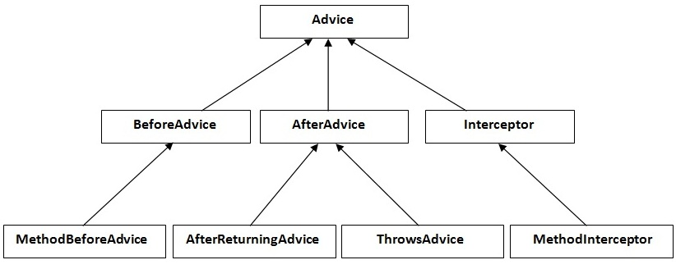
hierarchy of advice interfaces
MethodBeforeAdvice interface extends the BeforeAdvice interface.
AfterReturningAdvice interface extends the AfterAdvice interface.
ThrowsAdvice interface extends the AfterAdvice interface.
MethodInterceptor interface extends the Interceptor interface. It is used in around advice.

Slide 138
Spring AOP usage/Custom Aspects Implementation
Spring AOP can be used by 3 ways given below. But the widely used approach is Spring AspectJ Annotation Style. The 3 ways to use spring AOP are given below:
By Spring1.2 Old style (dtd based) (also supported in Spring3)
By AspectJ annotation-style
By Spring XML configuration-style(schema based)

Slide 139
Spring1.2 old style AOP (dtd based) implementation.
it is supported in spring 3, but it is recommended to use spring aop with aspectJ that we are going to learn in next page.
There are 4 types of advices supported in spring1.2 old style aop implementation.
Before Advice it is executed before the actual method call.
After Advice it is executed after the actual method call. If method returns a value, it is executed after returning value.
Around Advice it is executed before and after the actual method call.
Throws Advice it is executed if actual method throws exception.

Slide 140
1) MethodBeforeAdvice Example
File: A.java
Create a class that contains actual business logic.
package com.javatpoint;
public class A {
public void m(){System.out.println("actual business logic");}
}
File: BeforeAdvisor.java
Now, create the advisor class that implements MethodBeforeAdvice interface.
package com.javatpoint;
import java.lang.reflect.Method;
import org.springframework.aop.MethodBeforeAdvice;
public class BeforeAdvisor implements MethodBeforeAdvice{
@Override
public void before(Method method, Object[] args, Object target)throws Throwable {
System.out.println("additional concern before actual logic");
}
}

Slide 141
File: applicationContext.xml
In xml file, create 3 beans, one for A class, second for Advisor class and third for ProxyFactoryBean class.
<?xml version="1.0" encoding="UTF-8"?>
<beans
xmlns="http://www.springframework.org/schema/beans"
xmlns:xsi="http://www.w3.org/2001/XMLSchema-instance"
xmlns:p="http://www.springframework.org/schema/p"
xsi:schemaLocation="http://www.springframework.org/schema/beans
http://www.springframework.org/schema/beans/spring-beans-3.0.xsd">
<bean id="obj" class="com.javatpoint.A"></bean>
<bean id="ba" class="com.javatpoint.BeforeAdvisor"></bean>
<bean id="proxy" class="org.springframework.aop.framework.ProxyFactoryBean">
<property name="target" ref="obj"></property>
<property name="interceptorNames">
<list>
<value>ba</value>
</list>
</property>
</bean>
</beans>

Slide 142
Understanding ProxyFactoryBean class:
The ProxyFactoryBean class is provided by Spring Famework. It contains 2 properties target and interceptorNames. The instance of A class will be considered as target object and the instance of advisor class as interceptor. You need to pass the advisor object as the list object as in the xml file given above.
public class ProxyFactoryBean{
private Object target;
private List interceptorNames;
//getters and setters
}
Now, let's call the actual method.
File: Test.java
package com.javatpoint;
import org.springframework.beans.factory.BeanFactory;
import org.springframework.beans.factory.xml.XmlBeanFactory;
import org.springframework.core.io.ClassPathResource;
import org.springframework.core.io.Resource;
public class Test {
public static void main(String[] args) {
Resource r=new ClassPathResource("applicationContext.xml");
BeanFactory factory=new XmlBeanFactory(r);
A a=factory.getBean("proxy",A.class);
a.m();
}
}

Slide 143
Printing additional information in MethodBeforeAdvice
We can print additional information like method name, method argument, target object, target object class name, proxy class etc.
You need to change only two classes BeforeAdvisor.java and Test.java.
File: BeforeAdvisor.java
package com.javatpoint;
import java.lang.reflect.Method;
import org.springframework.aop.MethodBeforeAdvice;
public class BeforeAdvisor implements MethodBeforeAdvice{
@Override
public void before(Method method, Object[] args, Object target)throws Throwable {
System.out.println("additional concern before actual logic");
System.out.println("method info:"+method.getName()+" "+method.getModifiers());
System.out.println("argument info:");
for(Object arg:args)
System.out.println(arg);
System.out.println("target Object:"+target);
System.out.println("target object class name: "+target.getClass().getName());
}
}
File: Test.java
package com.javatpoint;
import org.springframework.beans.factory.BeanFactory;
import org.springframework.beans.factory.xml.XmlBeanFactory;
import org.springframework.core.io.ClassPathResource;
import org.springframework.core.io.Resource;
public class Test {
public static void main(String[] args) {
Resource r=new ClassPathResource("applicationContext.xml");
BeanFactory factory=new XmlBeanFactory(r);
A a=factory.getBean("proxy",A.class);
System.out.println("proxy class name: "+a.getClass().getName());
a.m();
}
}

Slide 144
2) AfterReturningAdvice Example
File: A.java
Create a class that contains actual business logic.
Same as in the previous example.
File: AfterAdvisor.java
Now, create the advisor class that implements AfterReturningAdvice interface.
package com.javatpoint;
import java.lang.reflect.Method;
import org.springframework.aop.AfterReturningAdvice;
public class AfterAdvisor implements AfterReturningAdvice{
@Override
public void afterReturning(Object returnValue, Method method,
Object[] args, Object target) throws Throwable {
System.out.println("additional concern after returning advice");
}
}

Slide 145
File: applicationContext.xml
Create the xml file as in the previous example, you need to change only the advisor class here.
<?xml version="1.0" encoding="UTF-8"?>
<beans
xmlns="http://www.springframework.org/schema/beans"
xmlns:xsi="http://www.w3.org/2001/XMLSchema-instance"
xmlns:p="http://www.springframework.org/schema/p"
xsi:schemaLocation="http://www.springframework.org/schema/beans
http://www.springframework.org/schema/beans/spring-beans-3.0.xsd">
<bean id="obj" class="com.javatpoint.A"></bean>
<bean id="ba" class="com.javatpoint.AfterAdvisor"></bean>
<bean id="proxy" class="org.springframework.aop.framework.ProxyFactoryBean">
<property name="target" ref="obj"></property>
<property name="interceptorNames">
<list>
<value>ba</value>
</list>
</property>
</bean>
</beans>
File: Test.java
Same as in the previous example.

Slide 146
3) MethodInterceptor (AroundAdvice) Example
class Testarray2{
File: A.java
Create a class that contains actual business logic.
Same as in the previous example.
Now, create the advisor class that implements MethodInterceptor interface.
File: AroundAdvisor.java
package com.javatpoint;
import org.aopalliance.intercept.MethodInterceptor;
import org.aopalliance.intercept.MethodInvocation;
public class AroundAdvisor implements MethodInterceptor{
@Override
public Object invoke(MethodInvocation mi) throws Throwable {
Object obj;
System.out.println("additional concern before actual logic");
obj=mi.proceed();
System.out.println("additional concern after actual logic");
return obj;
}
}

Slide 147
File: applicationContext.xml
Create the xml file as in the previous example, you need to change only the advisor class here.
<?xml version="1.0" encoding="UTF-8"?>
<beans
xmlns="http://www.springframework.org/schema/beans"
xmlns:xsi="http://www.w3.org/2001/XMLSchema-instance"
xmlns:p="http://www.springframework.org/schema/p"
xsi:schemaLocation="http://www.springframework.org/schema/beans
http://www.springframework.org/schema/beans/spring-beans-3.0.xsd">
<bean id="obj" class="com.javatpoint.A"></bean>
<bean id="ba" class="com.javatpoint.AroundAdvisor"></bean>
<bean id="proxy" class="org.springframework.aop.framework.ProxyFactoryBean">
<property name="target" ref="obj"></property>
<property name="interceptorNames">
<list>
<value>ba</value>
</list>
</property>
</bean>
</beans>
File: Test.java
Same as in the previous example.

Slide 148
4) ThrowsAdvice Example
Create a class that contains actual business logic.
File: Validator.java
package com.javatpoint;
public class Validator {
public void validate(int age)throws Exception{
if(age<18){
throw new ArithmeticException("Not Valid Age");
}
else{
System.out.println("vote confirmed");
}
}
}
Now, create the advisor class that implements ThrowsAdvice interface.
File: ThrowsAdvisor.java
package com.javatpoint;
import org.springframework.aop.ThrowsAdvice;
public class ThrowsAdvisor implements ThrowsAdvice{
public void afterThrowing(Exception ex){
System.out.println("additional concern if exception occurs");
}
}

Slide 149
File: applicationContext.xml
Create the xml file as in the previous example, you need to change only the Validator class and advisor class.
<?xml version="1.0" encoding="UTF-8"?>
<beans
xmlns="http://www.springframework.org/schema/beans"
xmlns:xsi="http://www.w3.org/2001/XMLSchema-instance"
xmlns:p="http://www.springframework.org/schema/p"
xsi:schemaLocation="http://www.springframework.org/schema/beans
http://www.springframework.org/schema/beans/spring-beans-3.0.xsd">
<bean id="obj" class="com.javatpoint.Validator"></bean>
<bean id="ba" class="com.javatpoint.ThrowsAdvisor"></bean>
<bean id="proxy" class="org.springframework.aop.framework.ProxyFactoryBean">
<property name="target" ref="obj"></property>
<property name="interceptorNames">
<list>
<value>ba</value>
</list>
</property>
</bean>
</beans>
File: Test.java
package com.javatpoint;
import org.springframework.beans.factory.BeanFactory;
import org.springframework.beans.factory.xml.XmlBeanFactory;
import org.springframework.core.io.ClassPathResource;
import org.springframework.core.io.Resource;
public class Test {
public static void main(String[] args) {
Resource r=new ClassPathResource("applicationContext.xml");
BeanFactory factory=new XmlBeanFactory(r);
Validator v=factory.getBean("proxy",Validator.class);
try{
v.validate(12);
}catch(Exception e){e.printStackTrace();}
}
}

Slide 150
Spring JDBC

Slide 151
Spring JDBC template
Spring JdbcTemplate is a powerful mechanism to connect to the database and execute SQL queries. It internally uses JDBC api, but eliminates a lot of problems of JDBC API.
Problems of JDBC API are
We need to write a lot of code before and after executing the query, such as creating connection, statement, closing resultset, connection etc.
We need to perform exception handling code on the database logic.
We need to handle transaction.
Repetition of all these codes from one to another database logic is a time consuming task.
Advantage of Spring JdbcTemplate
Spring JdbcTemplate eliminates all the above mentioned problems of JDBC API. It provides you methods to write the queries directly, so it saves a lot of work and time.
Spring Jdbc Approaches
Spring framework provides following approaches for JDBC database access:
JdbcTemplate
NamedParameterJdbcTemplate
SimpleJdbcTemplate
SimpleJdbcInsert and SimpleJdbcCall

Slide 152
JdbcTemplate class
It is the central class in the Spring JDBC support classes. It takes care of creation and release of resources such as creating and closing of connection object etc. So it will not lead to any problem if you forget to close the connection.
It handles the exception and provides the informative exception messages by the help of excepion classes defined in the org.springframework.dao package.
The JDBC Template class executes SQL queries, updates statements, stores procedure calls, performs iteration over ResultSets, and extracts returned parameter values. It also catches JDBC exceptions and translates them to the generic, more informative, exception hierarchy defined in the org.springframework.dao package.
Instances of the JdbcTemplate class are threadsafe once configured. So you can configure a single instance of a JdbcTemplate and then safely inject this shared reference into multiple DAOs.
A common practice when using the JDBC Template class is to configure a DataSource in your Spring configuration file, and then dependency-inject that shared DataSource bean into your DAO classes, and the JdbcTemplate is created in the setter for the DataSource.

Slide 153
Configuring Data Source
Let us create a database table Student in our database TEST. We assume you are working with MySQL database, if you work with any other database then you can change your DDL and SQL queries accordingly.
CREATE TABLE Student( ID INT NOT NULL AUTO_INCREMENT, NAME VARCHAR(20) NOT NULL, AGE INT NOT NULL, PRIMARY KEY (ID) );
Now we need to supply a DataSource to the JDBC Template so it can configure itself to get database access. You can configure the DataSource in the XML file with a piece of code as shown in the following code snippet −
<bean id = "dataSource" class = "org.springframework.jdbc.datasource.DriverManagerDataSource"> <property name = "driverClassName" value = "com.mysql.jdbc.Driver"/> <property name = "url" value = "jdbc:mysql://localhost:3306/TEST"/> <property name = "username" value = "root"/> <property name = "password" value = "password"/> </bean>

Slide 154
Data Access Object (DAO)
DAO stands for Data Access Object, which is commonly used for database interaction. DAOs exist to provide a means to read and write data to the database and they should expose this functionality through an interface by which the rest of the application will access them.
The DAO support in Spring makes it easy to work with data access technologies like JDBC, Hibernate, JPA, or JDO in a consistent way.

Slide 155
Executing SQL statements
Let us see how we can perform CRUD (Create, Read, Update and Delete) operation on database tables using SQL and JDBC Template object.
Querying for an integer
String SQL = "select count(*) from Student"; int rowCount = jdbcTemplateObject.queryForInt( SQL );Querying for a long
String SQL = "select count(*) from Student"; long rowCount = jdbcTemplateObject.queryForLong( SQL );A simple query using a bind variable
String SQL = "select age from Student where id = ?"; int age = jdbcTemplateObject.queryForInt(SQL, new Object[]{10});Querying for a String
String SQL = "select name from Student where id = ?"; String name = jdbcTemplateObject.queryForObject(SQL, new Object[]{10}, String.class);Querying and returning an object
String SQL = "select * from Student where id = ?"; Student student = jdbcTemplateObject.queryForObject( SQL, new Object[]{10}, new StudentMapper()); public class StudentMapper implements RowMapper<Student> { public Student mapRow(ResultSet rs, int rowNum) throws SQLException { Student student = new Student(); student.setID(rs.getInt("id")); student.setName(rs.getString("name")); student.setAge(rs.getInt("age")); return student; } }Querying and returning multiple objects
String SQL = "select * from Student"; List<Student> students = jdbcTemplateObject.query( SQL, new StudentMapper()); public class StudentMapper implements RowMapper<Student> { public Student mapRow(ResultSet rs, int rowNum) throws SQLException { Student student = new Student(); student.setID(rs.getInt("id")); student.setName(rs.getString("name")); student.setAge(rs.getInt("age")); return student; } }Inserting a row into the table
String SQL = "insert into Student (name, age) values (?, ?)"; jdbcTemplateObject.update( SQL, new Object[]{"Zara", 11} );Updating a row into the table
String SQL = "update Student set name = ? where id = ?"; jdbcTemplateObject.update( SQL, new Object[]{"Zara", 10} );Deleting a row from the table
String SQL = "delete Student where id = ?"; jdbcTemplateObject.update( SQL, new Object[]{20} ); ( SQL );

Slide 156
Executing DDL Statements
You can use the execute(..) method from jdbcTemplate to execute any SQL statements or DDL statements. Following is an example to use CREATE statement to create a table −
String SQL = "CREATE TABLE Student( " + "ID INT NOT NULL AUTO_INCREMENT, " + "NAME VARCHAR(20) NOT NULL, " + "AGE INT NOT NULL, " + "PRIMARY KEY (ID));" jdbcTemplateObject.execute( SQL );

Slide 157
Spring MVC

Slide 158
Spring MVC
A Java framework which is used to build web applications. It follows the Model-View-Controller design pattern. It implements all the basic features of a core spring framework like Inversion of Control, Dependency Injection.
A Spring MVC provides an elegant solution to use MVC in spring framework by the help of DispatcherServlet.
Here, DispatcherServlet is a class that receives the incoming request and maps it to the right resource such as controllers, models, and views.

Slide 159
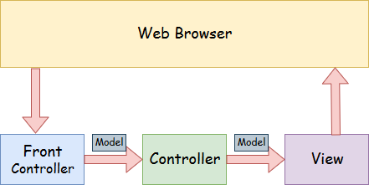
Spring MVC

Slide 160
Spring Web Model-View-Controller
Model - A model contains the data of the application. A data can be a single object or a collection of objects.
Controller - A controller contains the business logic of an application. Here, the @Controller annotation is used to mark the class as the controller.
View - A view represents the provided information in a particular format. Generally, JSP+JSTL is used to create a view page. Although spring also supports other view technologies such as Apache Velocity, Thymeleaf and FreeMarker.
Front Controller - In Spring Web MVC, the DispatcherServlet class works as the front controller. It is responsible to manage the flow of the Spring MVC application.

Slide 161
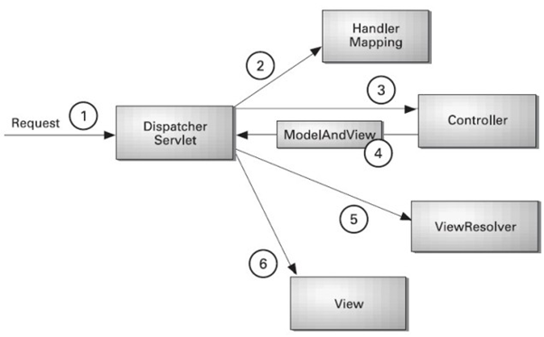
Understanding the flow of Spring Web MVC

Slide 162
Flow of Spring Web MVC
As displayed in the figure, all the incoming request is intercepted by the DispatcherServlet that works as the front controller.
The DispatcherServlet gets an entry of handler mapping from the XML file and forwards the request to the controller.
The controller returns an object of ModelAndView.
The DispatcherServlet checks the entry of view resolver in the XML file and invokes the specified view component.

Slide 163
Advantages of Spring MVC Framework
Separate roles - The Spring MVC separates each role, where the model object, controller, command object, view resolver, DispatcherServlet, validator, etc. can be fulfilled by a specialized object.
Light-weight - It uses light-weight servlet container to develop and deploy your application.
Powerful Configuration - It provides a robust configuration for both framework and application classes that includes easy referencing across contexts, such as from web controllers to business objects and validators.
Rapid development - The Spring MVC facilitates fast and parallel development.
Reusable business code - Instead of creating new objects, it allows us to use the existing business objects.
Easy to test - In Spring, generally we create JavaBeans classes that enable you to inject test data using the setter methods.
Flexible Mapping - It provides the specific annotations that easily redirect the page.

Slide 164
Spring Web MVC Framework Example
Load the spring jar files or add dependencies in the case of Maven
Create the controller class
Provide the entry of controller in the web.xml file
Define the bean in the separate XML file
Display the message in the JSP page
Start the server and deploy the project

Slide 165
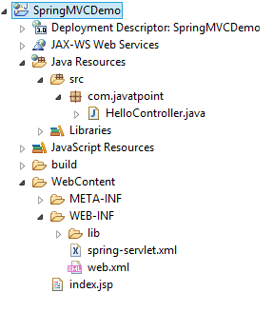
Directory Structure of Spring MVC

Slide 166
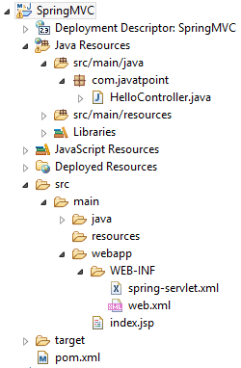
Directory Structure of Spring MVC using Maven

Slide 167
Required Jar files or Maven Dependency
To run this example, you need to load:
Spring Core jar files
Spring Web jar files
JSP + JSTL jar files (If you are using any another view technology then load the corresponding jar files).
Download Link: Download all the jar files for spring including JSP and JSTL.
If you are using Maven, you don't need to add jar files. Now, you need to add maven dependency to the pom.xml file.

Slide 168
1. Provide project information and configuration in the pom.xml file.
pom.xml
<project xmlns="http://maven.apache.org/POM/4.0.0" xmlns:xsi="http://www.w3.org/2001/XMLSchema-instance"
xsi:schemaLocation="http://maven.apache.org/POM/4.0.0 http://maven.apache.org/maven-v4_0_0.xsd">
<modelVersion>4.0.0</modelVersion>
<groupId>com.javatpoint</groupId>
<artifactId>SpringMVC</artifactId>
<packaging>war</packaging>
<version>0.0.1-SNAPSHOT</version>
<name>SpringMVC Maven Webapp</name>
<url>http://maven.apache.org</url>
<dependencies>
<dependency>
<groupId>junit</groupId>
<artifactId>junit</artifactId>
<version>3.8.1</version>
<scope>test</scope>
</dependency>
<!-- https://mvnrepository.com/artifact/org.springframework/spring-webmvc -->
<dependency>
<groupId>org.springframework</groupId>
<artifactId>spring-webmvc</artifactId>
<version>5.1.1.RELEASE</version>
</dependency>
<!-- https://mvnrepository.com/artifact/javax.servlet/javax.servlet-api -->
<dependency>
<groupId>javax.servlet</groupId>
<artifactId>servlet-api</artifactId>
<version>3.0-alpha-1</version>
</dependency>
</dependencies>
<build>
<finalName>SpringMVC</finalName>
</build>
</project>

Slide 169
2. Create the controller class
To create the controller class, we are using two annotations @Controller and @RequestMapping.
The @Controller annotation marks this class as Controller.
The @Requestmapping annotation is used to map the class with the specified URL name.
HelloController.java
package com.javatpoint;
import org.springframework.stereotype.Controller;
import org.springframework.web.bind.annotation.RequestMapping;
@Controller
public class HelloController {
@RequestMapping("/")
public String display()
{
return "index";
}
}

Slide 170
3. Provide the entry of controller in the web.xml file
In this xml file, we are specifying the servlet class DispatcherServlet that acts as the front controller in Spring Web MVC. All the incoming request for the html file will be forwarded to the DispatcherServlet.
web.xml
<?xml version="1.0" encoding="UTF-8"?>
<web-app xmlns:xsi="http://www.w3.org/2001/XMLSchema-instance" xmlns="http://java.sun.com/xml/ns/javaee" xsi:schemaLocation="http://java.sun.com/xml/ns/javaee http://java.sun.com/xml/ns/javaee/web-app_3_0.xsd" id="WebApp_ID" version="3.0">
<display-name>SpringMVC</display-name>
<servlet>
<servlet-name>spring</servlet-name>
<servlet-class>org.springframework.web.servlet.DispatcherServlet</servlet-class>
<load-on-startup>1</load-on-startup>
</servlet>
<servlet-mapping>
<servlet-name>spring</servlet-name>
<url-pattern>/</url-pattern>
</servlet-mapping>
</web-app>

Slide 171
4. Define the bean in the xml file
This is the important configuration file where we need to specify the View components.
The context:component-scan element defines the base-package where DispatcherServlet will search the controller class.
This xml file should be located inside the WEB-INF directory.
spring-servlet.xml
<?xml version="1.0" encoding="UTF-8"?>
<beans xmlns="http://www.springframework.org/schema/beans"
xmlns:xsi="http://www.w3.org/2001/XMLSchema-instance"
xmlns:context="http://www.springframework.org/schema/context"
xmlns:mvc="http://www.springframework.org/schema/mvc"
xsi:schemaLocation="
http://www.springframework.org/schema/beans
http://www.springframework.org/schema/beans/spring-beans.xsd
http://www.springframework.org/schema/context
http://www.springframework.org/schema/context/spring-context.xsd
http://www.springframework.org/schema/mvc
http://www.springframework.org/schema/mvc/spring-mvc.xsd">
<!-- Provide support for component scanning -->
<context:component-scan base-package="com.javatpoint" />
<!--Provide support for conversion, formatting and validation -->
<mvc:annotation-driven/>
</beans>

Slide 172
5. Display the message in the JSP page
This is the simple JSP page, displaying the message returned by the Controller.
index.jsp
<html>
<body>
<p>Welcome to Spring MVC Tutorial</p>
</body>
</html>

Slide 173
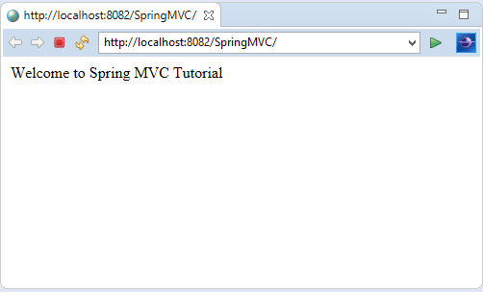
Output

Slide 174
Spring MVC Multiple View page Example
Here, we redirect a view page to another view page.
Let's see the simple example of a Spring Web MVC framework. The steps are as follows:
Load the spring jar files or add dependencies in the case of Maven
Create the controller class
Provide the entry of controller in the web.xml file
Define the bean in the separate XML file
Create the other view components
Start the server and deploy the project

Slide 175
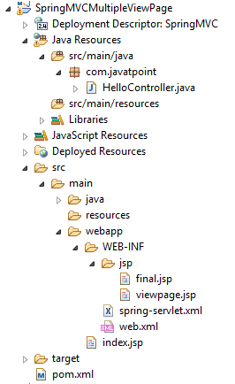
Directory Structure of Spring MVC

Slide 176
1. Add dependencies to pom.xml
<!-- https://mvnrepository.com/artifact/org.springframework/spring-webmvc -->
<dependency>
<groupId>org.springframework</groupId>
<artifactId>spring-webmvc</artifactId>
<version>5.1.1.RELEASE</version>
</dependency>
<!-- https://mvnrepository.com/artifact/javax.servlet/javax.servlet-api -->
<dependency>
<groupId>javax.servlet</groupId>
<artifactId>servlet-api</artifactId>
<version>3.0-alpha-1</version>
</dependency>

Slide 177
2. Create the request page
Let's create a simple jsp page containing a link.
index.jsp
<html>
<body>
<a href="hello">Click here...</a>
</body>
</html>

Slide 178
3. Create the controller class
Let's create a controller class that returns the JSP pages. Here, we pass the specific name with a @Requestmapping annotation to map the class.
HelloController.java
package com.javatpoint;
import org.springframework.stereotype.Controller;
import org.springframework.web.bind.annotation.RequestMapping;
@Controller
public class HelloController {
@RequestMapping("/hello")
public String redirect()
{
return "viewpage";
}
@RequestMapping("/helloagain")
public String display()
{
return "final";
}
}

Slide 179
4. Provide the entry of controller in the web.xml file
web.xml
<?xml version="1.0" encoding="UTF-8"?>
<web-app xmlns:xsi="http://www.w3.org/2001/XMLSchema-instance" xmlns="http://java.sun.com/xml/ns/javaee" xsi:schemaLocation="http://java.sun.com/xml/ns/javaee http://java.sun.com/xml/ns/javaee/web-app_3_0.xsd" id="WebApp_ID" version="3.0">
<display-name>SpringMVC</display-name>
<servlet>
<servlet-name>spring</servlet-name>
<servlet-class>org.springframework.web.servlet.DispatcherServlet</servlet-class>
<load-on-startup>1</load-on-startup>
</servlet>
<servlet-mapping>
<servlet-name>spring</servlet-name>
<url-pattern>/</url-pattern>
</servlet-mapping>
</web-app>

Slide 180
5. Define the bean in the xml file
Now, we also provide view resolver with view component.
Here, the InternalResourceViewResolver class is used for the ViewResolver.
The prefix+string returned by controller+suffix page will be invoked for the view component.
This xml file should be located inside the WEB-INF directory.
spring-servlet.xml
<?xml version="1.0" encoding="UTF-8"?>
<beans xmlns="http://www.springframework.org/schema/beans"
xmlns:xsi="http://www.w3.org/2001/XMLSchema-instance"
xmlns:context="http://www.springframework.org/schema/context"
xmlns:mvc="http://www.springframework.org/schema/mvc"
xsi:schemaLocation="
http://www.springframework.org/schema/beans
http://www.springframework.org/schema/beans/spring-beans.xsd
http://www.springframework.org/schema/context
http://www.springframework.org/schema/context/spring-context.xsd
http://www.springframework.org/schema/mvc
http://www.springframework.org/schema/mvc/spring-mvc.xsd">
<!-- Provide support for component scanning -->
<context:component-scan base-package="com.javatpoint" />
<!--Provide support for conversion, formatting and validation -->
<mvc:annotation-driven/>
<!-- Define Spring MVC view resolver -->
<bean id="viewResolver" class="org.springframework.web.servlet.view.InternalResourceViewResolver">
<property name="prefix" value="/WEB-INF/jsp/"></property>
<property name="suffix" value=".jsp"></property>
</bean>
</beans>

Slide 181
6. Create the other view components
viewpage.jsp
<html>
<body>
<a href="helloagain">Javatpoint Tutorials</a>
</body>
</html>
final.jsp
<html>
<body>
<p>Welcome to Spring MVC Tutorial</p>
</body>
</html>

Slide 182
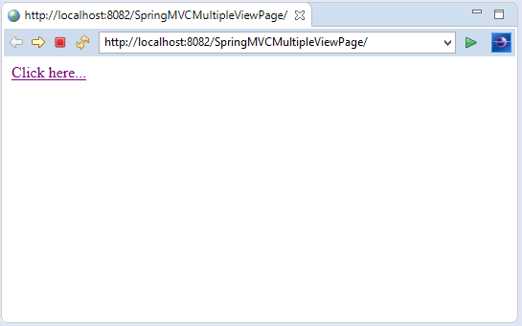
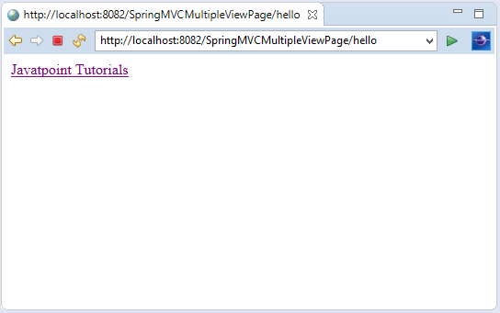
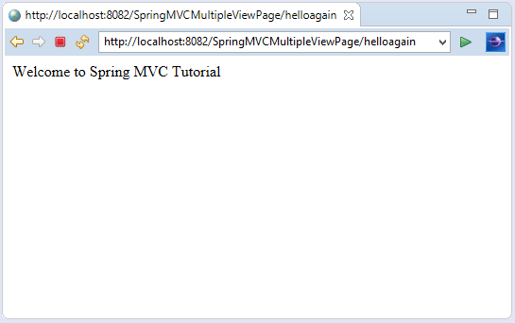
Output:

Slide 183
Spring MVC Multiple Controller Example
In Spring MVC, we can create multiple controllers at a time. It is required to map each controller class with @Controller annotation. Here, we see a Spring MVC example of multiple controllers. The steps are as follows:
Load the spring jar files or add dependencies in the case of Maven
Create the controller class
Provide the entry of controller in the web.xml file
Define the bean in the separate XML file
Create the other view components
Start the server and deploy the project

Slide 184
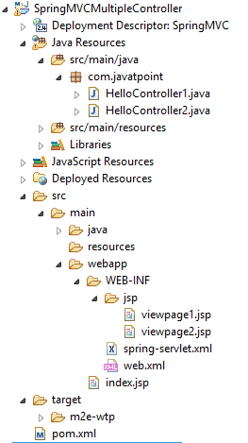
Directory Structure of Spring MVC

Slide 185
1. Add dependencies to pom.xml
<!-- https://mvnrepository.com/artifact/org.springframework/spring-webmvc -->
<dependency>
<groupId>org.springframework</groupId>
<artifactId>spring-webmvc</artifactId>
<version>5.1.1.RELEASE</version>
</dependency>
<!-- https://mvnrepository.com/artifact/javax.servlet/javax.servlet-api -->
<dependency>
<groupId>javax.servlet</groupId>
<artifactId>servlet-api</artifactId>
<version>3.0-alpha-1</version>
</dependency>

Slide 186
2. Create the request page
Let's create a simple JSP page containing two links.
index.jsp
<html>
<body>
<a href="hello1">Spring MVC</a> ||
<a href="hello2">Spring Boot</a>
</body>
</html>
3. Create the controller class
Let's create two controller classes, where each returns the particular view page.
HelloController1.java
package com.javatpoint;
import org.springframework.stereotype.Controller;
import org.springframework.web.bind.annotation.RequestMapping;
@Controller
public class HelloController1 {
@RequestMapping("/hello1")
public String display()
{
return "viewpage1";
}
}
HelloController2.java
package com.javatpoint;
import org.springframework.stereotype.Controller;
import org.springframework.web.bind.annotation.RequestMapping;
@Controller
public class HelloController2 {
@RequestMapping("/hello2")
public String display()
{
return "viewpage2";
}
}

Slide 187
4. Provide the entry of controller in the web.xml file
web.xml
<?xml version="1.0" encoding="UTF-8"?>
<web-app xmlns:xsi="http://www.w3.org/2001/XMLSchema-instance" xmlns="http://java.sun.com/xml/ns/javaee" xsi:schemaLocation="http://java.sun.com/xml/ns/javaee http://java.sun.com/xml/ns/javaee/web-app_3_0.xsd" id="WebApp_ID" version="3.0">
<display-name>SpringMVC</display-name>
<servlet>
<servlet-name>spring</servlet-name>
<servlet-class>org.springframework.web.servlet.DispatcherServlet</servlet-class>
<load-on-startup>1</load-on-startup>
</servlet>
<servlet-mapping>
<servlet-name>spring</servlet-name>
<url-pattern>/</url-pattern>
</servlet-mapping>
</web-app>

Slide 188
5. Define the bean in the xml file
spring-servlet.xml
<?xml version="1.0" encoding="UTF-8"?>
<beans xmlns="http://www.springframework.org/schema/beans"
xmlns:xsi="http://www.w3.org/2001/XMLSchema-instance"
xmlns:context="http://www.springframework.org/schema/context"
xmlns:mvc="http://www.springframework.org/schema/mvc"
xsi:schemaLocation="
http://www.springframework.org/schema/beans
http://www.springframework.org/schema/beans/spring-beans.xsd
http://www.springframework.org/schema/context
http://www.springframework.org/schema/context/spring-context.xsd
http://www.springframework.org/schema/mvc
http://www.springframework.org/schema/mvc/spring-mvc.xsd">
<!-- Provide support for component scanning -->
<context:component-scan base-package="com.javatpoint" />
<!--Provide support for conversion, formatting and validation -->
<mvc:annotation-driven/>
<bean id="viewResolver" class="org.springframework.web.servlet.view.InternalResourceViewResolver">
<property name="prefix" value="/WEB-INF/jsp/"></property>
<property name="suffix" value=".jsp"></property>
</bean>
</beans>

Slide 189
6. Create the other view components
viewpage1.jsp
<html>
<body>
<p>Welcome to Spring MVC Tutorial</p>
</body>
</html>
viewpage1.jsp
<html>
<body>
<p>Welcome to Spring Boot Tutorial</p>
</body>
</html>

Slide 190
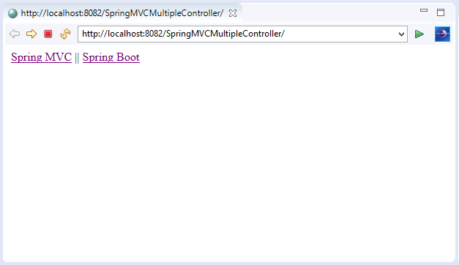
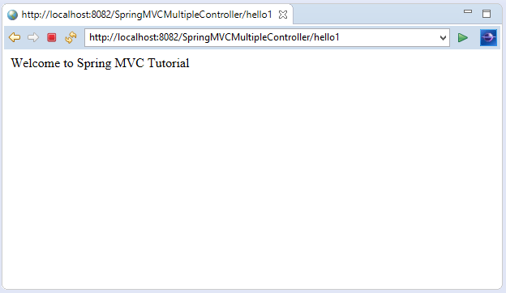
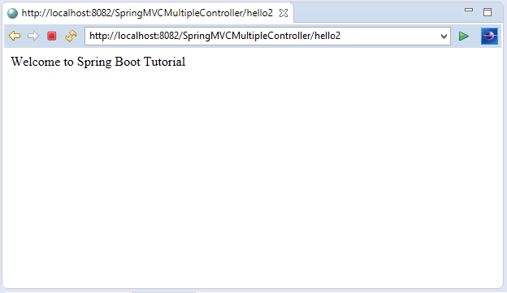
Output:

Slide 191
Spring MVC Model Interface
In Spring MVC, the model works a container that contains the data of the application. Here, a data can be in any form such as objects, strings, information from the database, etc.
It is required to place the Model interface in the controller part of the application. The object of HttpServletRequest reads the information provided by the user and pass it to the Model interface. Now, a view page easily accesses the data from the model part.

Slide 192
Methods of Model Interface
Method | Description
Model addAllAttributes(Collection<?> arg) | It adds all the attributes in the provided Collection into this Map.
Model addAllAttributes(Map<String,?> arg) | It adds all the attributes in the provided Map into this Map.
Model addAllAttribute(Object arg) | It adds the provided attribute to this Map using a generated name.
Model addAllAttribute(String arg0, Object arg1) | It binds the attribute with the provided name.
Map<String, Object> asMap() | It return the current set of model attributes as a Map.
Model mergeAttributes(Map< String,?> arg) | It adds all attributes in the provided Map into this Map, with existing objects of the same name taking precedence.
boolean containsAttribute(String arg) | It indicates whether this model contains an attribute of the given name

Slide 193
Spring MVC Model Example
Let's create a login page that contains a username and password. Here, we validate the password with a specific value.
1. Add dependencies to pom.xml
<!-- https://mvnrepository.com/artifact/org.springframework/spring-webmvc -->
<dependency>
<groupId>org.springframework</groupId>
<artifactId>spring-webmvc</artifactId>
<version>5.1.1.RELEASE</version>
</dependency>
<!-- https://mvnrepository.com/artifact/javax.servlet/javax.servlet-api -->
<dependency>
<groupId>javax.servlet</groupId>
<artifactId>servlet-api</artifactId>
<version>3.0-alpha-1</version>
</dependency>

Slide 194
2. Create the request page
Here, we create the login page to receive name and password from the user.
index.jsp
<html>
<body>
<form action="hello">
UserName : <input type="text" name="name"/> <br><br>
Password : <input type="text" name="pass"/> <br><br>
<input type="submit" name="submit">
</form>
</body>
</html>

Slide 195
3. Create the controller class
In controller class:
The HttpServletRequest is used to read the HTML form data provided by the user.
The Model contains the request data and provides it to view page.
HelloController.java
package com.javatpoint;
import javax.servlet.http.HttpServletRequest;
import org.springframework.stereotype.Controller;
import org.springframework.ui.Model;
import org.springframework.web.bind.annotation.RequestMapping;
@Controller
public class HelloController {
@RequestMapping("/hello")
public String display(HttpServletRequest req,Model m)
{
//read the provided form data
String name=req.getParameter("name");
String pass=req.getParameter("pass");
if(pass.equals("admin"))
{
String msg="Hello "+ name;
//add a message to the model
m.addAttribute("message", msg);
return "viewpage";
}
else
{
String msg="Sorry "+ name+". You entered an incorrect password";
m.addAttribute("message", msg);
return "errorpage";
}
}
}

Slide 196
4. Provide the entry of controller in the web.xml file
web.xml
<?xml version="1.0" encoding="UTF-8"?>
<web-app xmlns:xsi="http://www.w3.org/2001/XMLSchema-instance" xmlns="http://java.sun.com/xml/ns/javaee" xsi:schemaLocation="http://java.sun.com/xml/ns/javaee http://java.sun.com/xml/ns/javaee/web-app_3_0.xsd" id="WebApp_ID" version="3.0">
<display-name>SpringMVC</display-name>
<servlet>
<servlet-name>spring</servlet-name>
<servlet-class>org.springframework.web.servlet.DispatcherServlet</servlet-class>
<load-on-startup>1</load-on-startup>
</servlet>
<servlet-mapping>
<servlet-name>spring</servlet-name>
<url-pattern>/</url-pattern>
</servlet-mapping>
</web-app>

Slide 197
5. Define the bean in the xml file
spring-servlet.xml
<?xml version="1.0" encoding="UTF-8"?>
<beans xmlns="http://www.springframework.org/schema/beans"
xmlns:xsi="http://www.w3.org/2001/XMLSchema-instance"
xmlns:context="http://www.springframework.org/schema/context"
xmlns:mvc="http://www.springframework.org/schema/mvc"
xsi:schemaLocation="
http://www.springframework.org/schema/beans
http://www.springframework.org/schema/beans/spring-beans.xsd
http://www.springframework.org/schema/context
http://www.springframework.org/schema/context/spring-context.xsd
http://www.springframework.org/schema/mvc
http://www.springframework.org/schema/mvc/spring-mvc.xsd">
<!-- Provide support for component scanning -->
<context:component-scan base-package="com.javatpoint" />
<!--Provide support for conversion, formatting and validation -->
<mvc:annotation-driven/>
<bean id="viewResolver" class="org.springframework.web.servlet.view.InternalResourceViewResolver">
<property name="prefix" value="/WEB-INF/jsp/"></property>
<property name="suffix" value=".jsp"></property>
</bean>
</beans>

Slide 198
6. Create the other view components
To run this example, the following view components must be located inside the WEB-INF/jsp directory.
viewpage.jsp
<html>
<body>
${message}
</body>
</html>
errorpage.jsp
<html>
<body>
${message}
<br><br>
<jsp:include page="/index.jsp"></jsp:include>
</body>
</html>

Slide 199
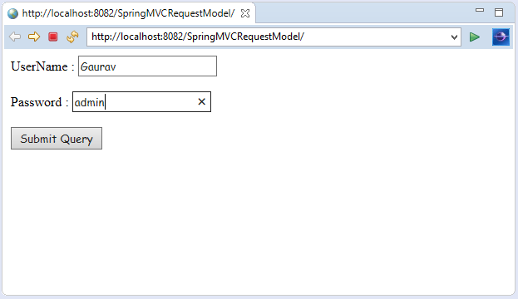
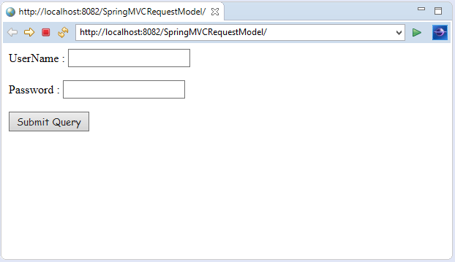
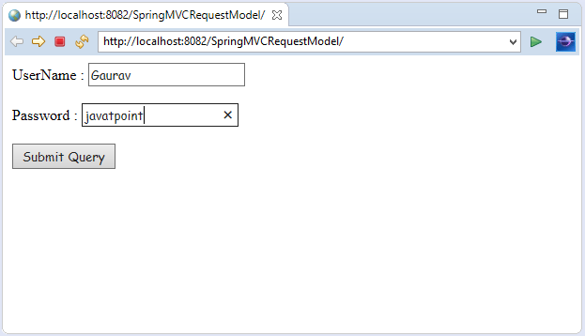
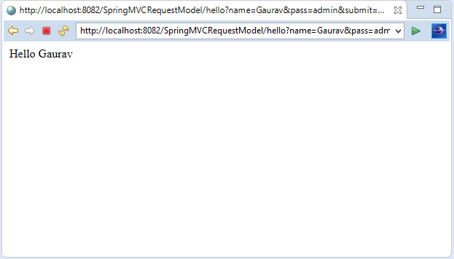
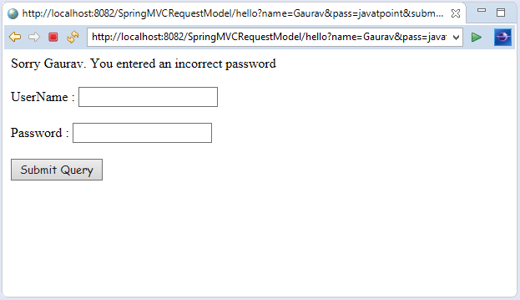
Output:

Slide 200
Spring MVC RequestParam Annotation
In Spring MVC, the @RequestParam annotation is used to read the form data and bind it automatically to the parameter present in the provided method. So, it ignores the requirement of HttpServletRequest object to read the provided data.
Including form data, it also maps the request parameter to query parameter and parts in multipart requests. If the method parameter type is Map and a request parameter name is specified, then the request parameter value is converted to a Map else the map parameter is populated with all request parameter names and values.

Slide 201
Spring MVC RequestParam Example
Let's create a login page that contains a username and password. Here, we validate the password with a specific value.
1. Add dependencies to pom.xml
<!-- https://mvnrepository.com/artifact/org.springframework/spring-webmvc -->
<dependency>
<groupId>org.springframework</groupId>
<artifactId>spring-webmvc</artifactId>
<version>5.1.1.RELEASE</version>
</dependency>
<!-- https://mvnrepository.com/artifact/javax.servlet/javax.servlet-api -->
<dependency>
<groupId>javax.servlet</groupId>
<artifactId>servlet-api</artifactId>
<version>3.0-alpha-1</version>
</dependency>

Slide 202
2. Create the request page
It is the login page that receive name and password from the user.
index.jsp
<html>
<body>
<form action="hello">
UserName : <input type="text" name="name"/> <br><br>
Password : <input type="text" name="pass"/> <br><br>
<input type="submit" name="submit">
</form>
</body>
</html>

Slide 203
3. Create the Controller Class
In controller class:
The @RequestParam is used to read the HTML form data provided by a user and bind it to the request parameter.
The Model contains the request data and provides it to view page.
HelloController.java
package com.javatpoint;
import org.springframework.stereotype.Controller;
import org.springframework.ui.Model;
import org.springframework.web.bind.annotation.RequestMapping;
import org.springframework.web.bind.annotation.RequestParam;
@Controller
public class HelloController {
@RequestMapping("/hello")
//read the provided form data
public String display(@RequestParam("name") String name,@RequestParam("pass") String pass,Model m)
{
if(pass.equals("admin"))
{
String msg="Hello "+ name;
//add a message to the model
m.addAttribute("message", msg);
return "viewpage";
}
else
{
String msg="Sorry "+ name+". You entered an incorrect password";
m.addAttribute("message", msg);
return "errorpage";
}
}
}

Slide 204
4. Create the other view components
To run this example, the following view components must be located inside the WEB-INF/jsp directory.
viewpage.jsp
<html>
<body>
${message}
</body>
</html>
errorpage.jsp
<html>
<body>
${message}
<br><br>
<jsp:include page="/index.jsp"></jsp:include>
</body>
</html>
</html>

Slide 205

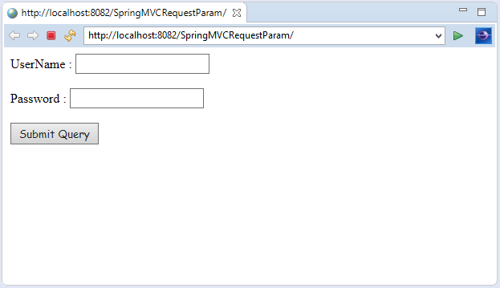
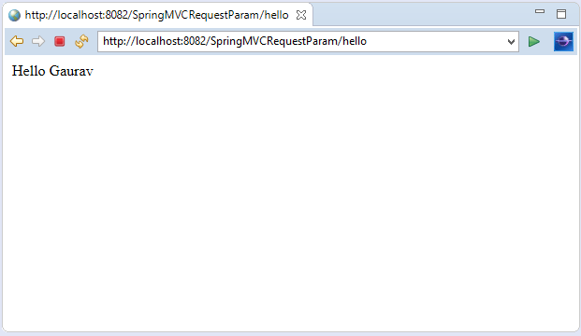
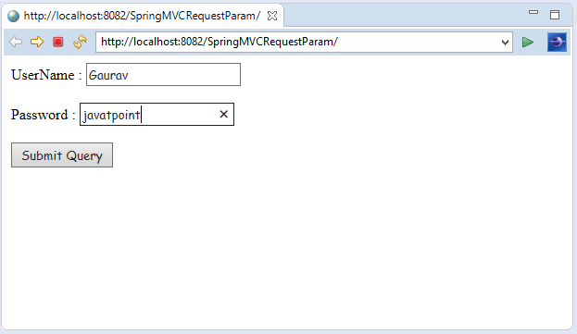
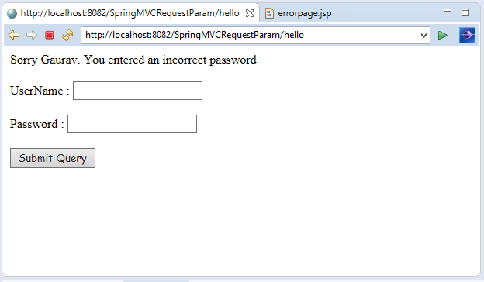
OUTPUT:

Slide 206
Spring Boot - Building RESTful Web Services

Slide 207
RESTful Web Services -Introduction
REST stands for REpresentational State Transfer. It is developed by Roy Thomas Fielding, who also developed HTTP. The main goal of RESTful web services is to make web services more effective. RESTful web services try to define services using the different concepts that are already present in HTTP. REST is an architectural approach, not a protocol.
It does not define the standard message exchange format. We can build REST services with both XML and JSON. JSON is more popular format with REST. The key abstraction is a resource in REST. A resource can be anything. It can be accessed through a Uniform Resource Identifier (URI). For example:
The resource has representations like XML, HTML, and JSON. The current state capture by representational resource. When we request a resource, we provide the representation of the resource. The important methods of HTTP are:
GET: It reads a resource.
PUT: It updates an existing resource.
POST: It creates a new resource.
DELETE: It deletes the resource.

Slide 208
social media application
, we get the corresponding results.
POST /users: It creates a user.
GET /users/{id}: It retrieves the detail of a user.
GET /users: It retrieves the detail of all users.
DELETE /users: It deletes all users.
DELETE /users/{id}: It deletes a user.
GET /users/{id}/posts/post_id: It retrieve the detail of a specific post.
POST / users/{id}/ posts: It creates a post of the user.

Slide 209
HTTP Status code
404: RESOURCE NOT FOUND
200: SUCCESS
201: CREATED
401: UNAUTHORIZED
500: SERVER ERROR

Slide 210
RESTful Service Constraints
There must be a service producer and service consumer.
The service is stateless.
The service result must be cacheable.
The interface is uniform and exposing resources.
The service should assume a layered architecture.

Slide 211
Advantages of RESTful web services
RESTful web services are platform-independent.
It can be written in any programming language and can be executed on any platform.
It provides different data format like JSON, text, HTML, and XML.
It is fast in comparison to SOAP because there is no strict specification like SOAP.
These are reusable.
They are language neutral.

Slide 212
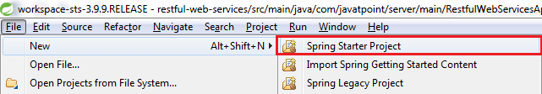
Initializing a RESTful Web Services Project with Spring Boot
Step 1: Download the Spring Tool Suite (STS) from https://spring.io/tools3/sts/all and extract it.
Step 2: Launch the STS.
Step 3: Click on File menu -> New -> Spring Starter Project ->

Slide 213
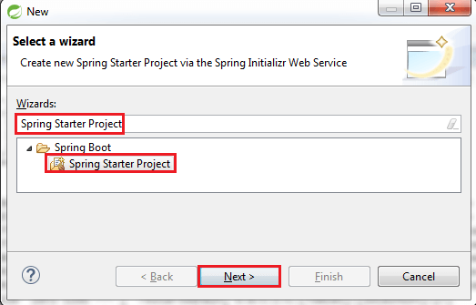
If the Spring Starter Project is not enlisted, then click on Other at the bottom of the menu. A dialog box appears on the screen. Type Spring Starter Project in the Wizards text box and click on the Next button.

Slide 214
Step 4: provide the name, group, and package of the project. We have provided:
Name: restful-web-services
Group: com.javatpoint
Package: com.javatpoint.server.main
Click on the Next button.

Slide 215
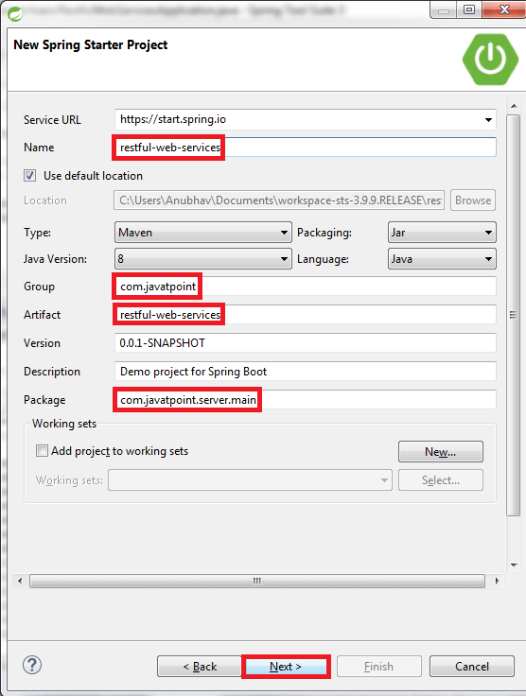

Slide 216
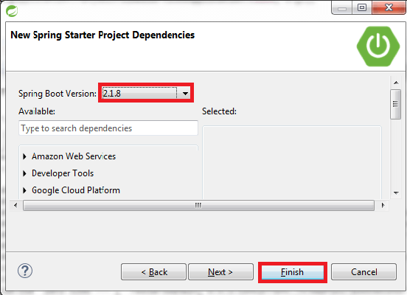
Step 5: Choose the Spring Boot Version 2.1.8.

Slide 217
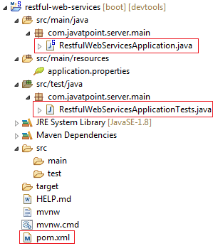
Step 6: We can see the project structure in the project explorer window.

Slide 218
Step 7:
Go to the Maven Repository https://mvnrepository.com/ and add Spring Web MVC, Spring Boot DevTools, JPA, and H2 dependencies in the pom.xml. After adding the dependencies, the pom.xml file looks like the following:
pom.xml
<project xmlns="http://maven.apache.org/POM/4.0.0"
xmlns:xsi="http://www.w3.org/2001/XMLSchema-instance"
xsi:schemaLocation="http://maven.apache.org/POM/4.0.0
http://maven.apache.org/xsd/maven-4.0.0.xsd">
<modelVersion>4.0.0</modelVersion>
<parent>
<groupId>org.springframework.boot</groupId>
<artifactId>spring-boot-starter-parent</artifactId>
<version>2.1.8.RELEASE</version>
<relativePath/> <!-- lookup parent from repository -->
</parent>
<groupId>com.javatpoint</groupId>
<artifactId>restful-web-services</artifactId>
<version>0.0.1-SNAPSHOT</version>
<name>restful-web-services</name>
<description>Demo project for Spring Boot</description>
<properties>
<java.version>1.8</java.version>
</properties>
<dependencies>
<dependency>
<groupId>org.springframework.boot</groupId>
<artifactId>spring-boot-starter</artifactId>
</dependency>
<dependency>
<groupId>org.springframework.boot</groupId>
<artifactId>spring-boot-starter-activemq</artifactId>
</dependency>
<dependency>
<groupId>org.springframework.boot</groupId>
<artifactId>spring-boot-starter-web</artifactId>
</dependency>
<dependency>
<groupId>org.springframework.boot</groupId>
<artifactId>spring-boot-starter-tomcat</artifactId>
</dependency>
<dependency>
<groupId>org.springframework</groupId>
<artifactId>spring-webmvc</artifactId>
</dependency>
<!-- https://mvnrepository.com/artifact/org.springframework.boot/spring-boot-devtools -->
<dependency>
<groupId>org.springframework.boot</groupId>
<artifactId>spring-boot-devtools</artifactId>
<scope>runtime</scope>
</dependency>
<!-- https://mvnrepository.com/artifact/org.hibernate.javax.persistence/hibernate-jpa-2.1-api -->
<dependency>
<groupId>org.hibernate.javax.persistence</groupId>
<artifactId>hibernate-jpa-2.1-api</artifactId>
<version>1.0.0.Final</version>
</dependency>
<!-- https://mvnrepository.com/artifact/com.h2database/h2 -->
<dependency>
<groupId>com.h2database</groupId>
<artifactId>h2</artifactId>
<scope>runtime</scope>
</dependency>
<dependency>
<groupId>org.apache.maven</groupId>
<artifactId>maven-archiver</artifactId>
<version>2.5</version>
</dependency>
<dependency>
<groupId>org.springframework.boot</groupId>
<artifactId>spring-boot-starter-test</artifactId>
<scope>test</scope>
</dependency>
</dependencies>
<build>
<plugins>
<plugin>
<groupId>org.springframework.boot</groupId>
<artifactId>spring-boot-maven-plugin</artifactId>
</plugin>
</plugins>
</build>
</project>

Slide 219
Step 8
Now open the RestfulWebServicesApplication.java file and Run the file as Java Application.
package com.javatpoint.server.main;
import org.springframework.boot.SpringApplication;
import org.springframework.boot.autoconfigure.SpringBootApplication;
@SpringBootApplication
public class RestfulWebServicesApplication
{
public static void main(String[] args)
{
SpringApplication.run(RestfulWebServicesApplication.class, args);
}
}
It does not perform any service but ensures that the application is running properly.

Slide 220
Output

Slide 221
Creating a Hello World Service
Step 1: Create a new class with the name HelloWorldController in the package com.javatpoint.server.main.
Step 2: Whenever we create a web service, we need to define two things Get method and the URI. Now create the helloWorld() method which returns the string "Hello World." If we want to tell the spring MVC that it is going to handle the REST request, we have to add @RestController annotation. Now it becomes a rest controller which can handle the Rest request.
The next thing we have to do is create a mapping for the method. Add @RequestMapping annotation just above the helloWorld() method.

Slide 222
HelloWorldController
The HelloWorldController looks like the following:
package com.javatpoint.server.main;
import org.springframework.web.bind.annotation.RequestMapping;
import org.springframework.web.bind.annotation.RequestMethod;
import org.springframework.web.bind.annotation.RestController;
//Controller
@RestController
public class HelloWorldController
{
//using get method and hello-world as URI
@RequestMapping(method=RequestMethod.GET, path="/hello-world")
public String helloWorld()
{
return "Hello World";
}
}

Slide 223
@GetMapping annotation instead of @RequestMapping.
We can also improve the above code by using the @GetMapping annotation instead of @RequestMapping. Here the method specification is not required.
package com.javatpoint.server.main;
import org.springframework.web.bind.annotation.GetMapping;
import org.springframework.web.bind.annotation.RestController;
//Controller
@RestController
public class HelloWorldController
{
//using get method and hello-world as URI
@GetMapping(path="/hello-world")
public String helloWorld()
{
return "Hello World";
}
}
Step 3: Run the RestfulWebServiceApplication. It displays the string Hello World on the browser.

Slide 224
Enhancing the Hello World Service to Return a Bean
In this section, we are going to generate a bean for the method helloWorld().
Step 1: Create a helloWorldBean() method in HelloWordController.java file. Map the URI to "/hello-world-bean" and return HelloWorldBean.
HelloWorldController.java
package com.javatpoint.server.main;
import org.springframework.web.bind.annotation.GetMapping;
import org.springframework.web.bind.annotation.RestController;
//Controller
@RestController
public class HelloWorldController
{
//using get method and hello-world URI
@GetMapping(path="/hello-world")
public String helloWorld()
{
return "Hello World";
}
@GetMapping(path="/hello-world-bean")
public HelloWorldBean helloWorldBean()
{
return new HelloWorldBean("Hello World"); //constructor of HelloWorldBean
}
}

Slide 225
Step 2: Create a class HelloWorldBean.
Step 3: Generate Getters and Setters.
Right-click -> Source -> Generate Getters and Setters -> check the box -> Ok
Step 4: Generate toString()..
Right-click -> Source -> Generate toString().. -> Ok

Slide 226
HelloWorldBean.java
package com.javatpoint.server.main;
public class HelloWorldBean
{
public String message;
//constructor of HelloWorldBean
public HelloWorldBean(String message)
{
this.message=message;
}
//generating getters and setters
public String getMessage()
{
return message;
}
public void setMessage(String message)
{
this.message = message;
}
@Override
//generate toString
public String toString()
{
return String.format ("HelloWorldBean [message=%s]", message);
}
}
Step 5: Launch the HelloWorldController. The URL of the browser changes to localhost:8080/hello-world-bean.
It returns the message "Hello World" in JSON format.
{
message: "Hello World"
}

Slide 227
Difference between Spring and SpringBoot
Where it’s used? | Spring framework is a java EE framework that is used to build applications. | Spring Boot framework is mainly used to develop REST API’s
Key feature | The primary or most important feature of the Spring framework is dependency injection(Dependency Injection (DI) is a design technique that removes dependencies from computer code, making the application easier to maintain and test). | The main or primary feature of the Spring Boot is Autoconfiguration( Simply described, Spring Boot autoconfiguration is a method of automatically configuring a Spring application based on the dependencies found on the classpath.) Autoconfiguration can speed up and simplify development by removing the need to define some beans that are part of the auto-configuration classes.
Why it’s used | Its goal is to make Java EE (Enterprise Edition) development easier, allowing developers to be more productive. | Spring Boot provides the RAD(Rapid Application Development) feature to the Spring framework for faster application development.
Type of Application Development | Spring framework helps to create a loosely coupled application. | Spring Boot helps to create a stand-alone application.
Servers dependency | In the Spring framework to test the Spring Project, we need to set up the servers explicitly. | Spring Boot offers built-in or embedded servers such as Tomcat and jetty.
Deployment descriptor | To run a Spring application a deployment descriptor is required. | In Spring Boot there is no need for the Deployment descriptor.
In-memory database support | Spring framework does not provide support for the in-memory database. | Spring Boot provides support for the in-memory database such as H2.
Boilerplate code | Spring framework requires too many lines of code (boilerplate code) even for minimal tasks. | You avoid boilerplate code which reduces time and increases productivity.
Configurations | In the Spring framework, you have to build configurations manually. | In Spring Boot there are default configurations that allow faster bootstrapping.
Dependencies | Spring Framework requires a number of dependencies to create a web app. | Spring Boot, on the other hand, can get an application working with just one dependency. There are several more dependencies required during build time that is added to the final archive by default.
HTTP Authentication | HTTP Basic Authentication is for enabling security confirmations, it indicates that several dependencies and configurations need to be enabled to enable security. Spring requires both the standard spring-security-web and spring-security-config dependencies to set up security in an application. Next, we need to add a class that extends the WebSecurityConfigurerAdapter and makes use of the @EnableWebSecurity annotation. | Spring Boot also requires these dependencies to make it work, but we only need to define the dependency of spring-boot-starter-security as this will automatically add all the relevant dependencies to the classpath.
Testing | Testing in Spring Boot is difficult in comparison to Spring Boot due to a large amount of source code. | Testing in Spring Boot is easier due to the reduced amount of source code.
XML Configuration | In the Spring framework, XML Configuration is required. | No need for XML configuration in Spring Boot.
CLI Tools | Spring framework does not provide any CLI tool for developing and testing applications. | Spring Boot provides a CLI tool for developing and testing Spring Boot applications.
Plugins | Spring framework does not provide any plugin for maven, Gradle, etc. like Spring Boot. | Spring Boot provides build tool plugins for Maven and Gradle. The Plugins offer a variety of features, including the packaging of executable jars.

